Slide 1
Nanomechanical Computing
Philip Turner
Notes:
I am Philip Turner
Giving a presentation on nanomechanical computing
Sponsored by Virginia Tech
Department of Electrical and Computer Engineering
Official undergraduate research course titled “Nanomechanical Computer Subsystem”, lasting for one semester

Slide 2
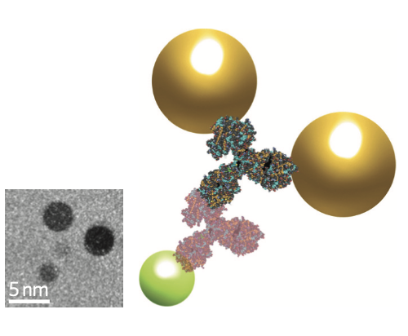
What is the smallest computer that existing technology can build?
Protein Transistor
Notes:
Smallest computer permitted by the laws of physics
999 nm sphere
A form of magnetic memory that must separated 100 nm away to function correctly, 10 nm would lose its data after a few seconds. Even if the device itself is small, what matters is the minimum distance two devices can be separated
Maximize the volume available to store a computer:
Shapeshifting microbot spanning several tens of microns
Controls nanobot with infrared light, a few tens of microns tethering
Covered with CNT antennas pointing every possible direction

Slide 3
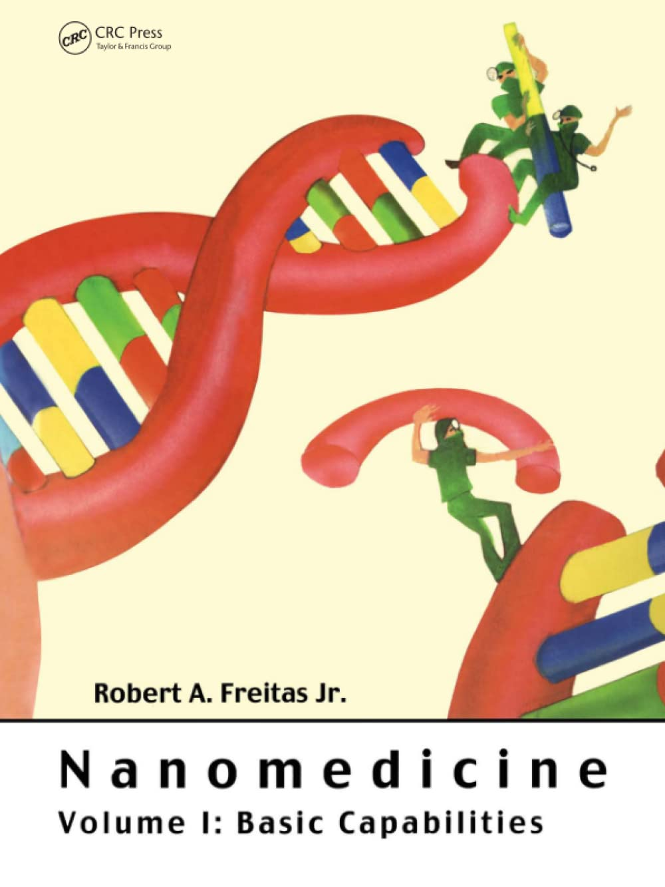
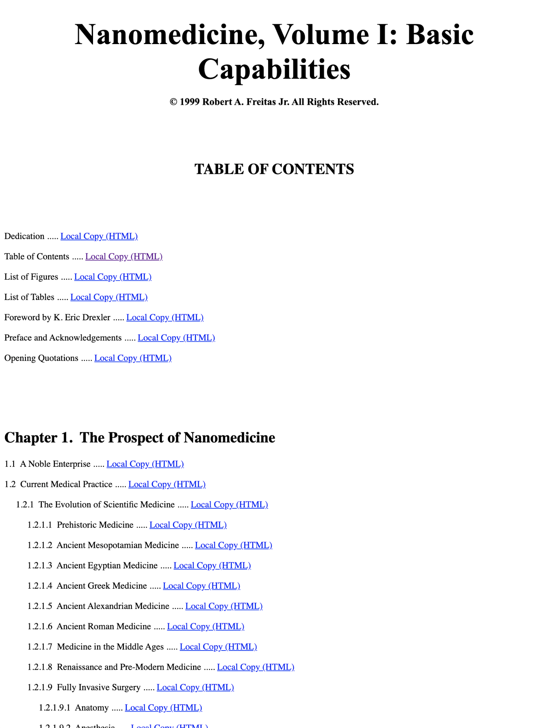
Nanomedicine (1999)
Open Access Website
Notes:
Microbot-nanobot architecture not viable:
Any object travelling through capillaries must be 2 microns or less
Power budget of 10 trillionths of a watt
Read Nanomedicine from start to end
Material properties of diamond
Low bandwidth for sending data into body
Trillions of nanobots need trillions of control signals
Magnetic field only one bit per second, would send the same signal to all nanobots simultaneously (SIMD)
They need a different signal (MIMD)
Also, need to extract sensor data out of the body to establish feedback loop for robot control
Nanobots must carry compute, data storage onboard
Device specifications require computer in 60 nm sphere
Atomic precision is needed to make medical nanobots a reality

Slide 4
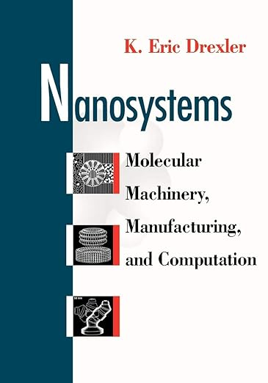
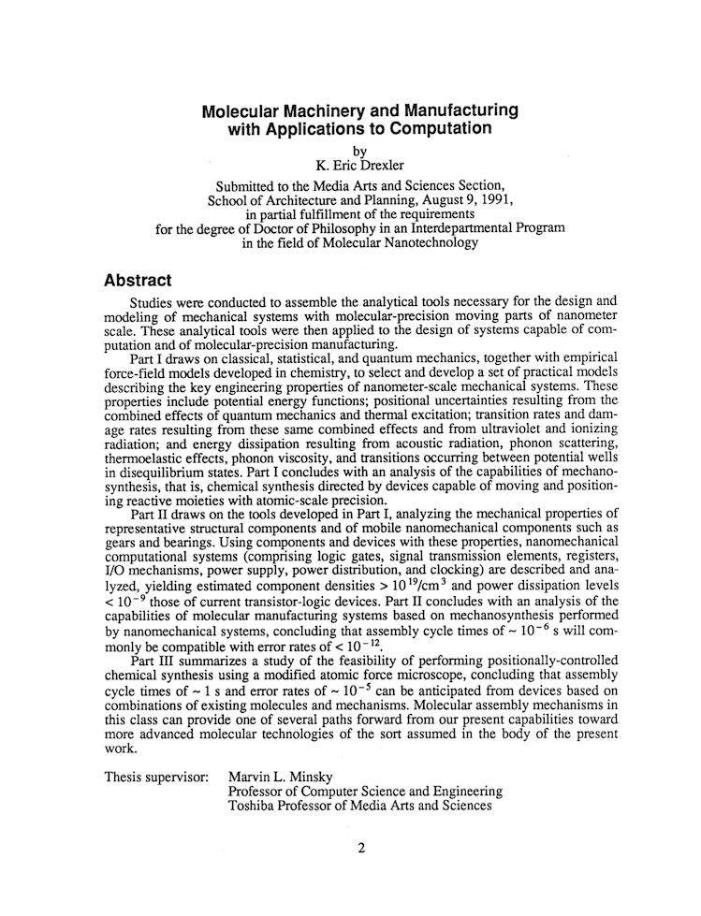
Nanosystems (1992)
Open Access Thesis
Notes:
Give Eric Drexler a chance
Nanosystems:
First page sounded very reasonable
Second chapter discussed scaling laws
Scaling laws:
Explain SA:V as example of scaling law
Electromagnets, strength becomes negligible when the entire device is smaller than 10 nm
DC currents can work at 10 nm, but packed closer together they leak current. Proven with NAND flash memory (14 nm)
Electrostatic forces are the only viable one at sub-10-nm scales
Helical electrical fields computer by Ralph Merkle
Mechanical devices:
Not limited to just electronic computers
Atomic precision would allow atomically smooth surfaces
Removes damage mechanisms and energy dissipation mechanisms characteristic of friction at macroscale

Slide 5
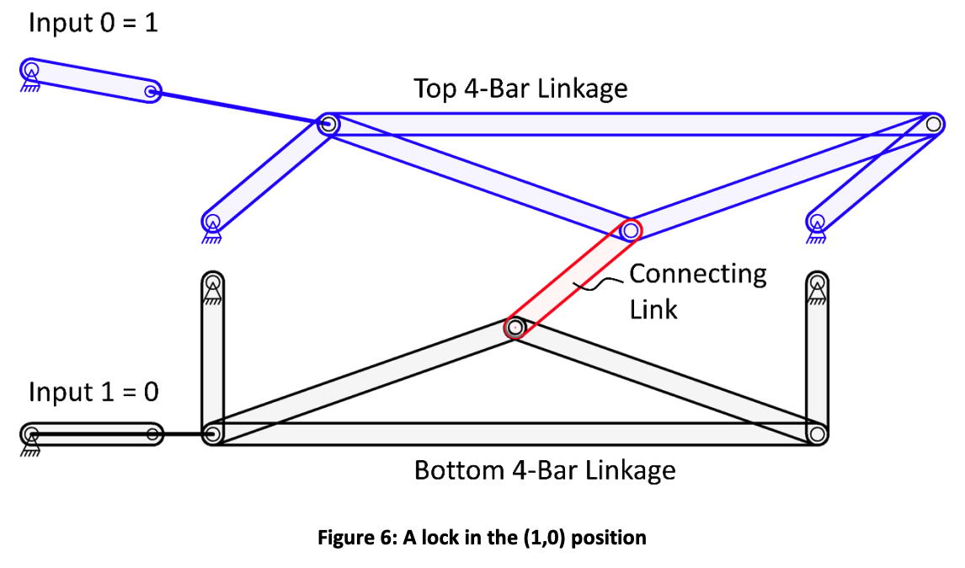
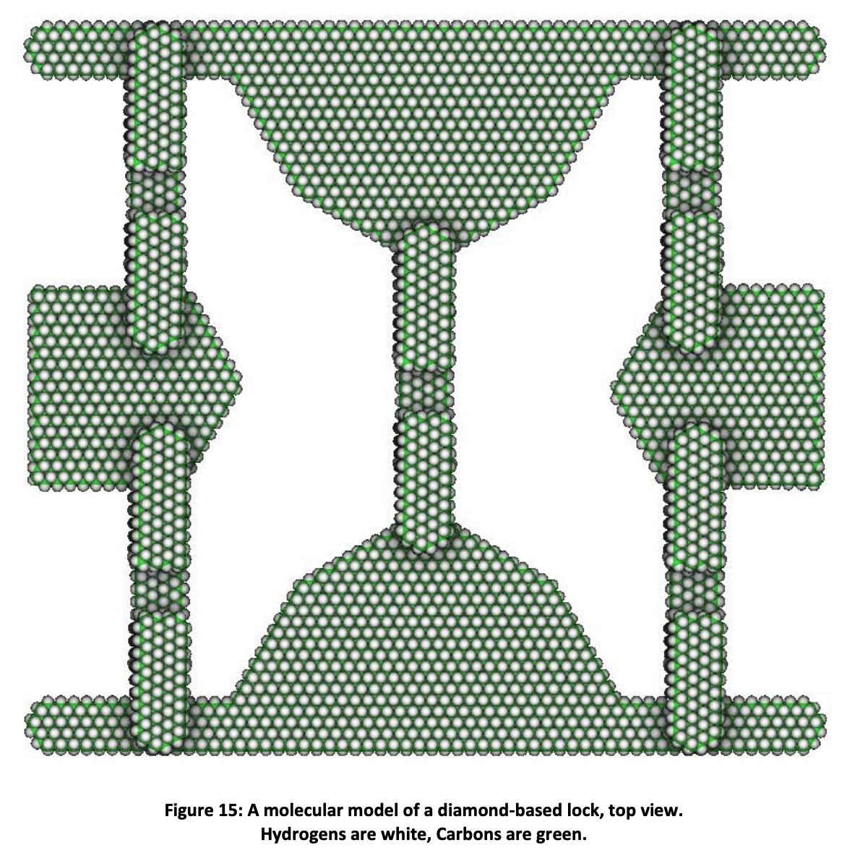
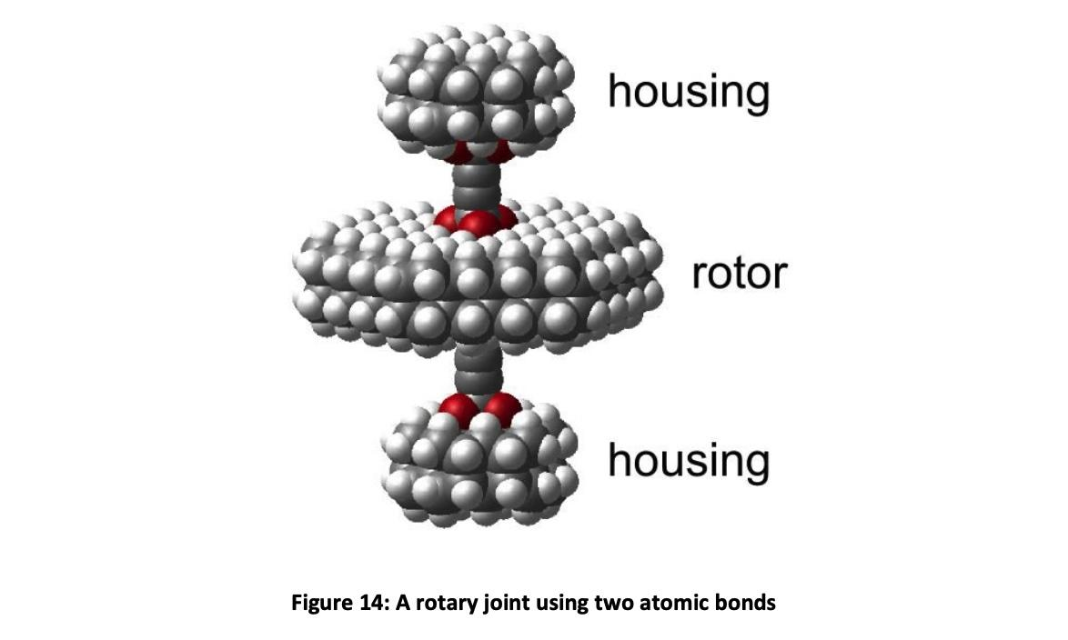
Molecular Link Logic
Notes:
Robert Freitas and Ralph Merkle invented molecular link logic
Published on IMM.org in 2016
1 million times more efficient than cutting-edge transistor
Requires reversible computing to overcome the Landauer limit, and fully utilize its efficiency

Slide 6
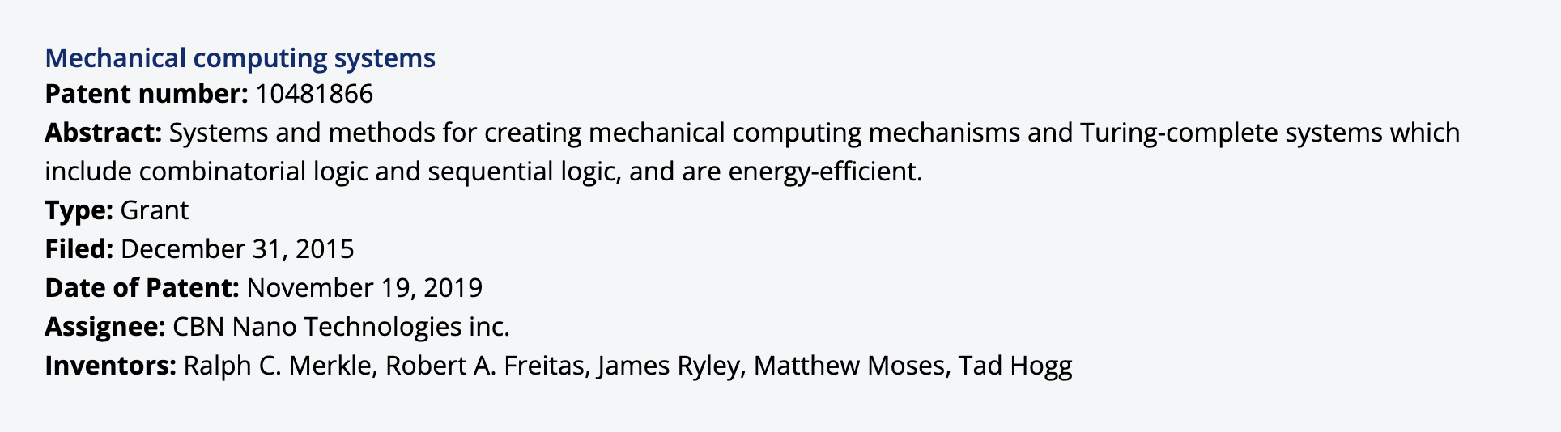
Molecular Link Logic: Private Intellectual Property
Notes:
Robert Freitas
Author of nanomedicine
Diamond mechanosynthesis literature review
Stopped producing research papers in 2012
US20130178626
“Atomically-Precise Products and Methods and Systems for Manufacturing the Same”
2013: filed by Freitas and Merkle
2017: assigned to Nanofactory Corporation
2017: reassigned to CBN Nano Technologies [say with spacing between each word to clarify]
Filed patent on MLL before publishing to IMM.org or ArXiv.org
Well over a dozen patents, with over 10 different people signing
Don’t want to be involved with this private intellectual property
Need a public and accessible alternative to MLL

Slide 7
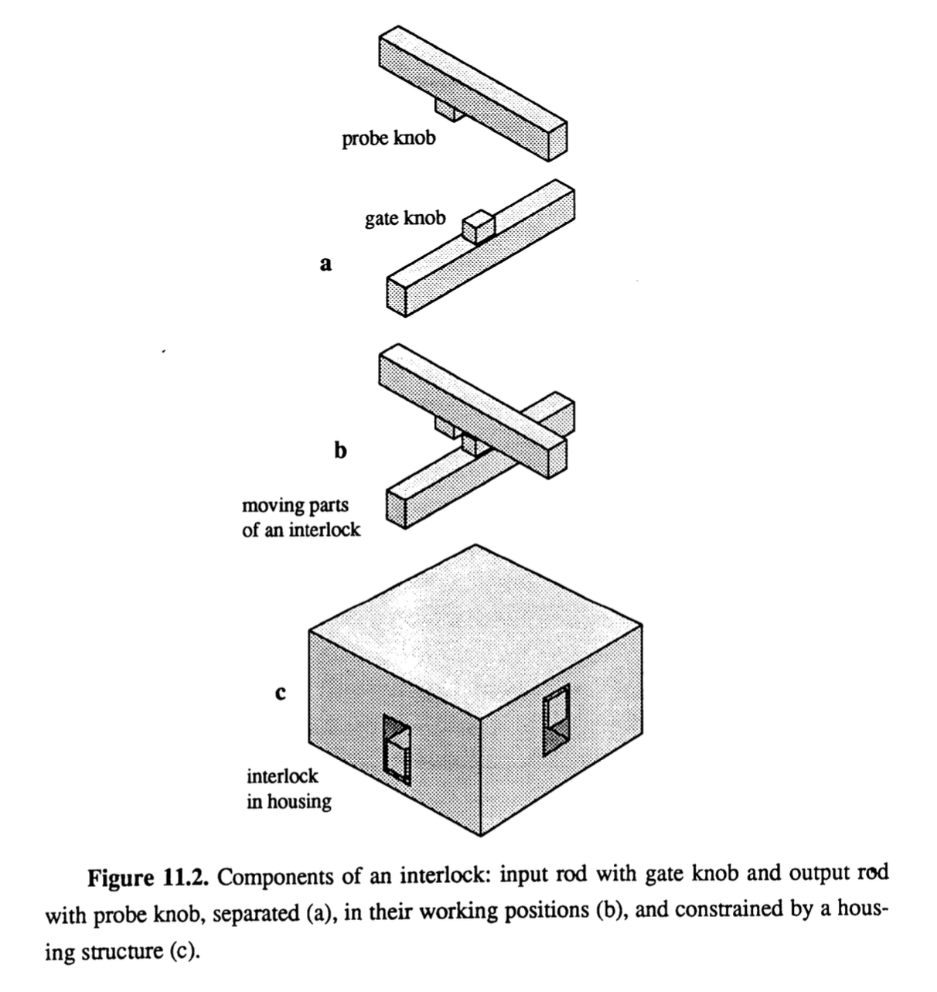
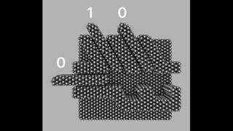
Rod Logic: Open Alternative
Schematic from Drexler’s thesis
200,000 atoms/gate → 2,000 atoms/gate
Notes:
This alternative is rod logic
Invented by Eric Drexler in 1988
Originally with polyyne rods
More refined version uses this diamond rods, around 4 atomic layers thick
Thick enough that continuum mechanics starts to dominate device behavior
Diamond is also much less reactive than polyyne
Physical obstruction of a moving rod
Explain that gray atoms are carbon, white atoms are hydrogen
Input rod prevents the output from moving
[Activate YouTube video of NOR gate] Video of NOR gate
Much more compact
Small enough that you can simulate a logic gate with molecular dynamics
Not at efficient as MLL, but efficient enough
Also overcomes the Landauer limit

Slide 8
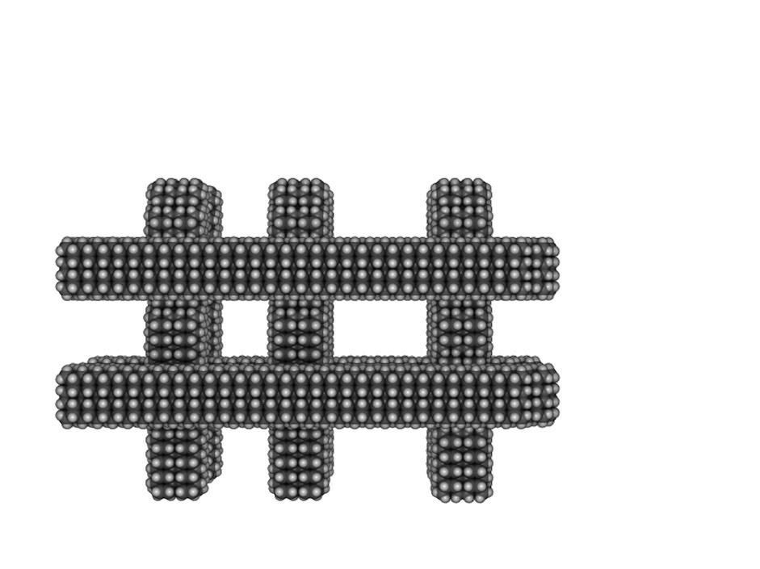
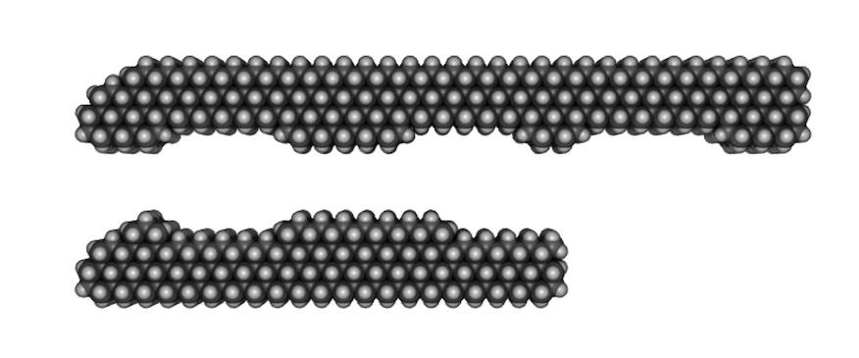
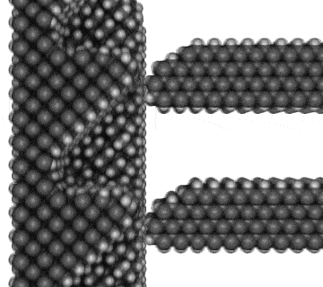
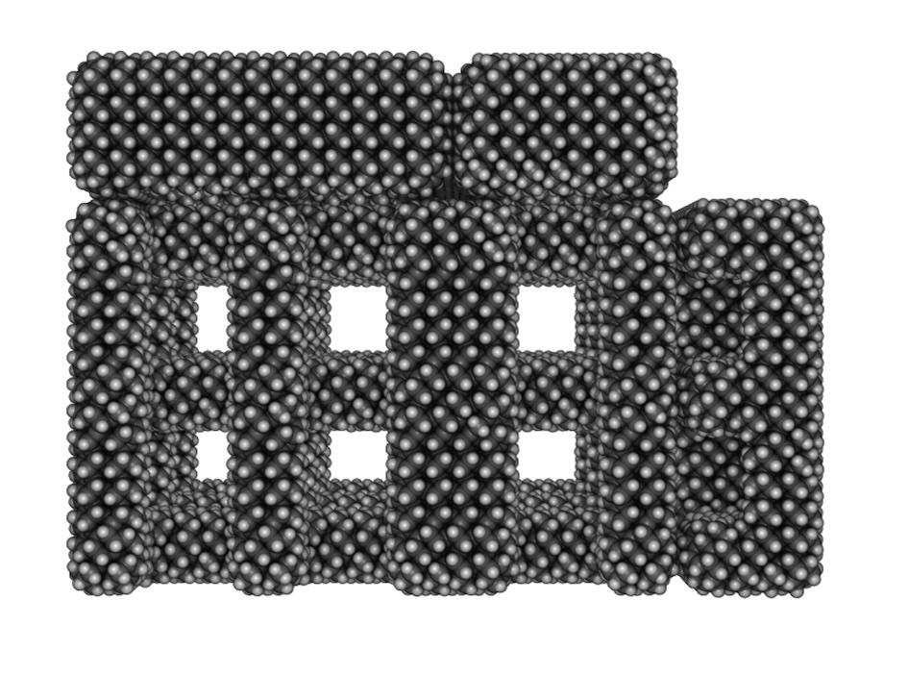
Rod Logic: Open Alternative
rods
patterns
housing
drive wall
Notes:
Explain that this is the logic for a parallel 2-bit half adder
Explain how the drive wall uses the van der Waals force and the Pauli repulsion force
Noncontact forces available at nanoscale
Coulomb forces between ions
vdW force
Pauli repulsion force
Explain the parallelism of drive walls, and origin of the name

Slide 9
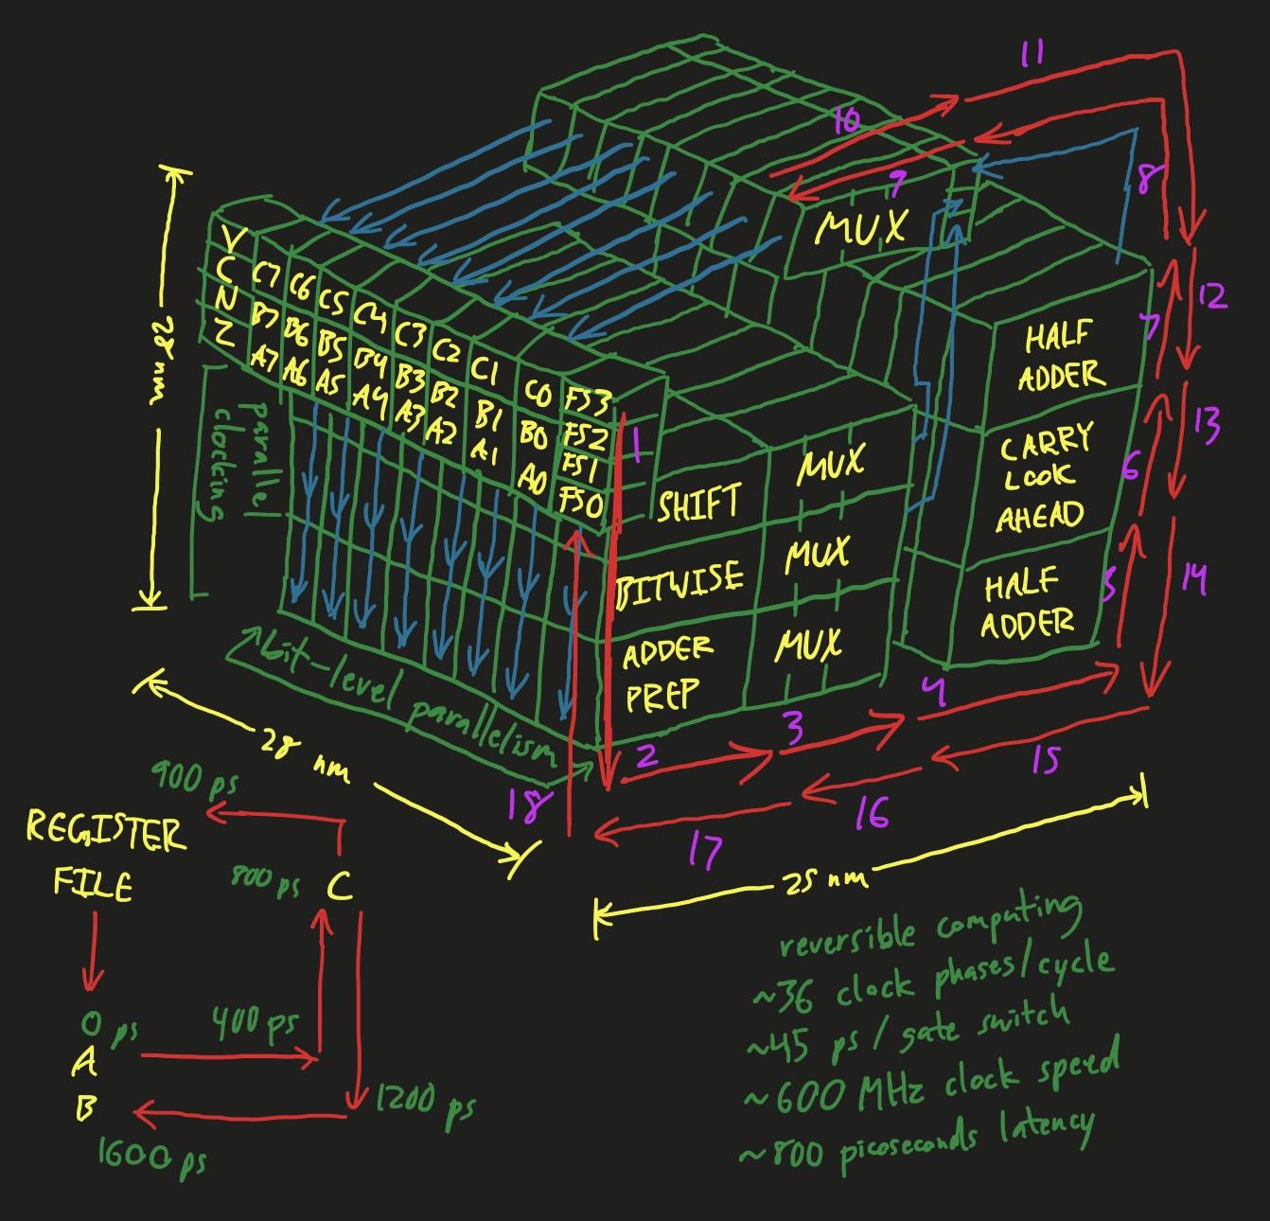
What would a rod logic computer look like?
Notes:
Around 5 million atoms
Note that each red arrow is 2 phases
Forward and reverse clocking sequence

Slide 10
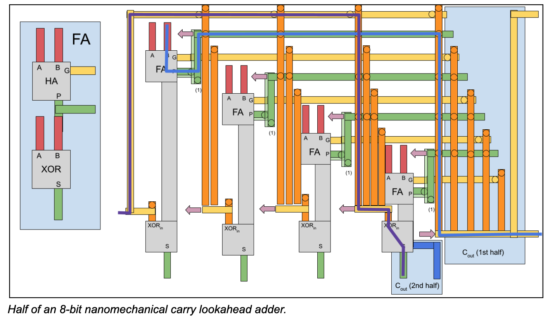
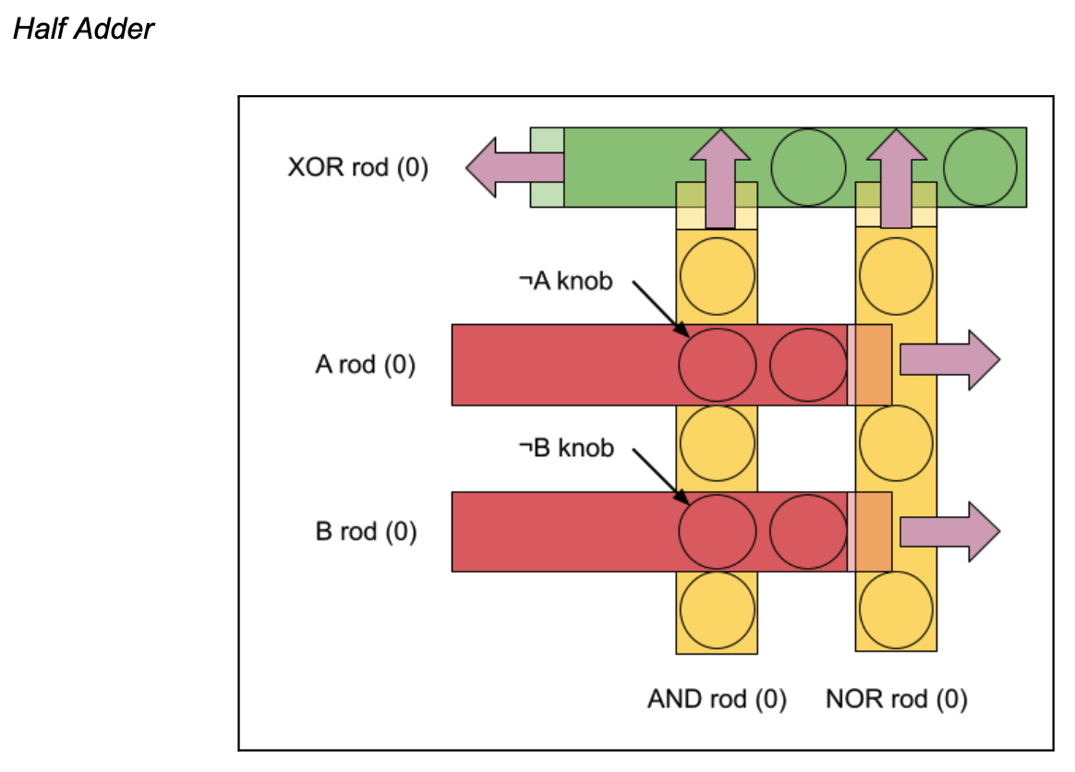
Critical element of a computer: 4-bit CLA
Notes:
Carry lookahead adder minimizes the number of clock phases in an ALU

Slide 11
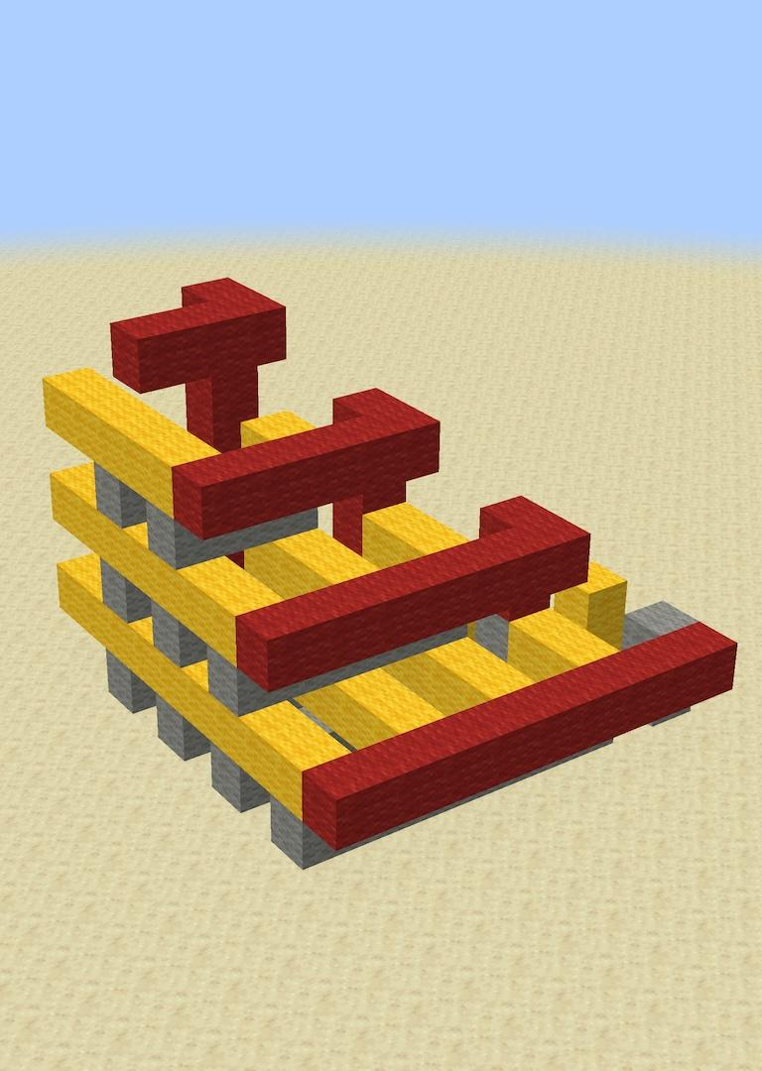
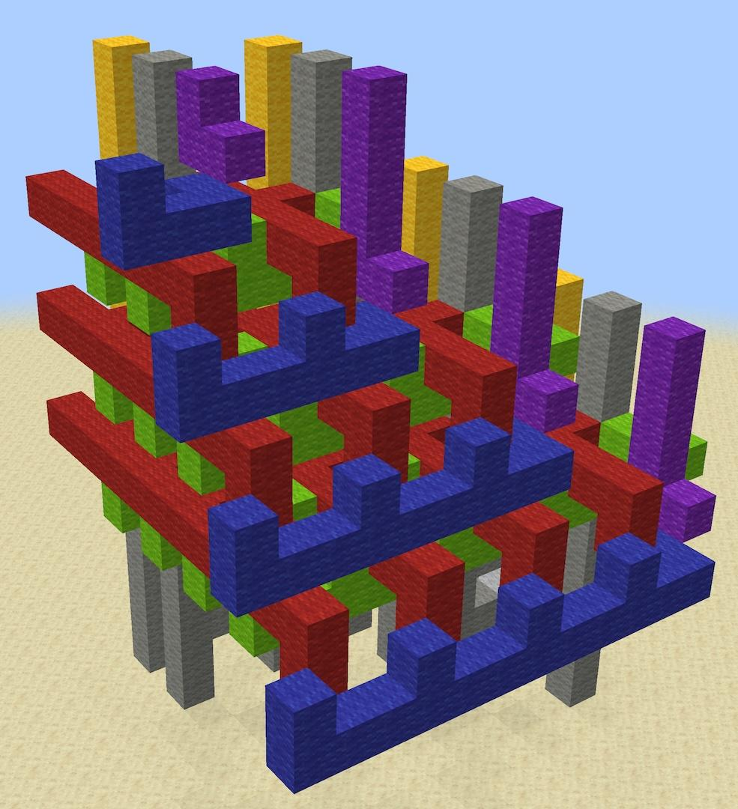
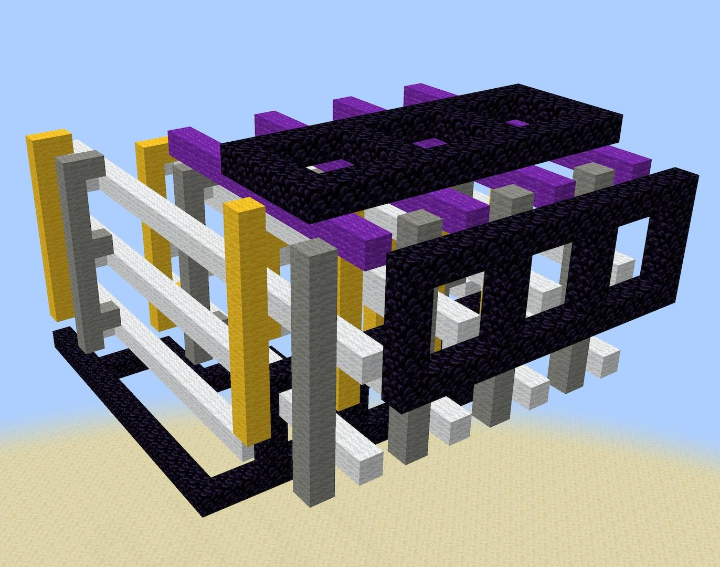
Attempts to draft in Minecraft
drive “wall” actuating 8 rods at once
Draft 1
Draft 2
Draft 3
Notes:
Tried drafting a rod logic ALU in Minecraft

Slide 12
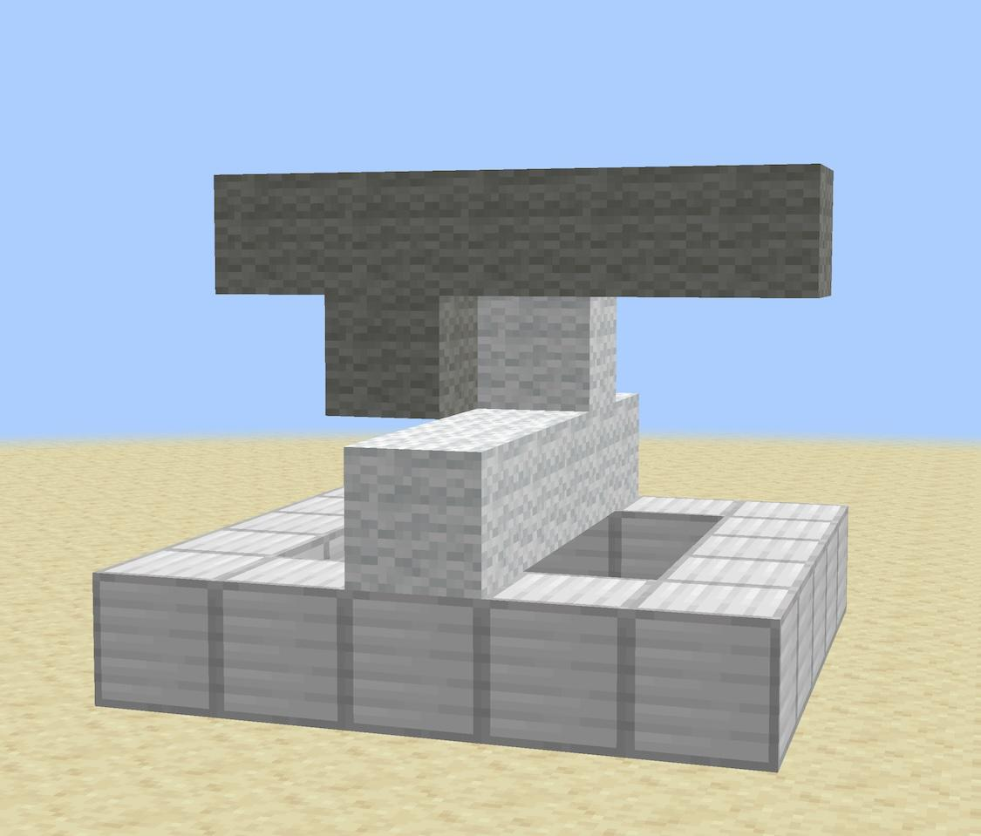
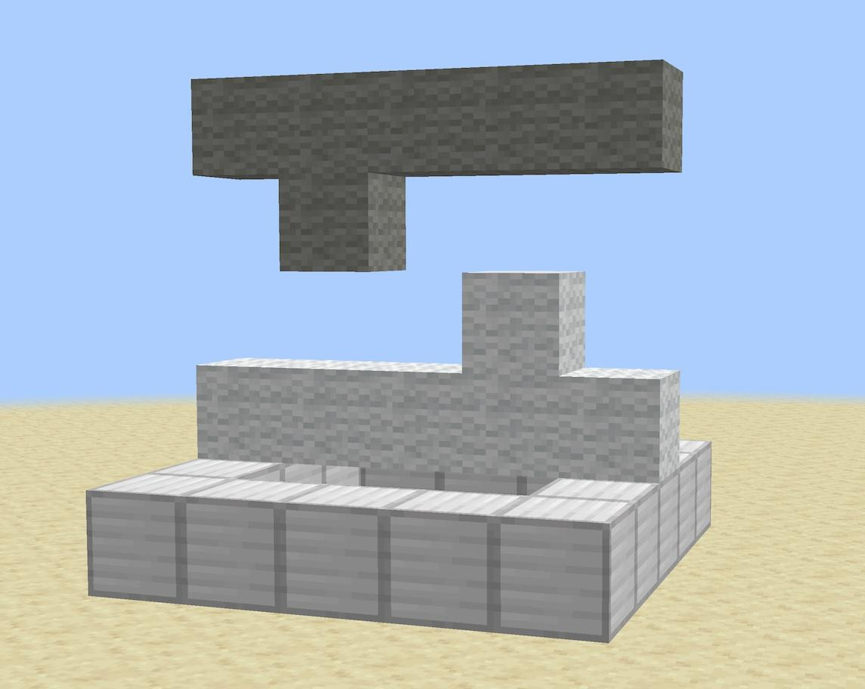
Formalizing Rod Logic
switch – fundamental building block
pattern – knobs, inversion of signals

Slide 13
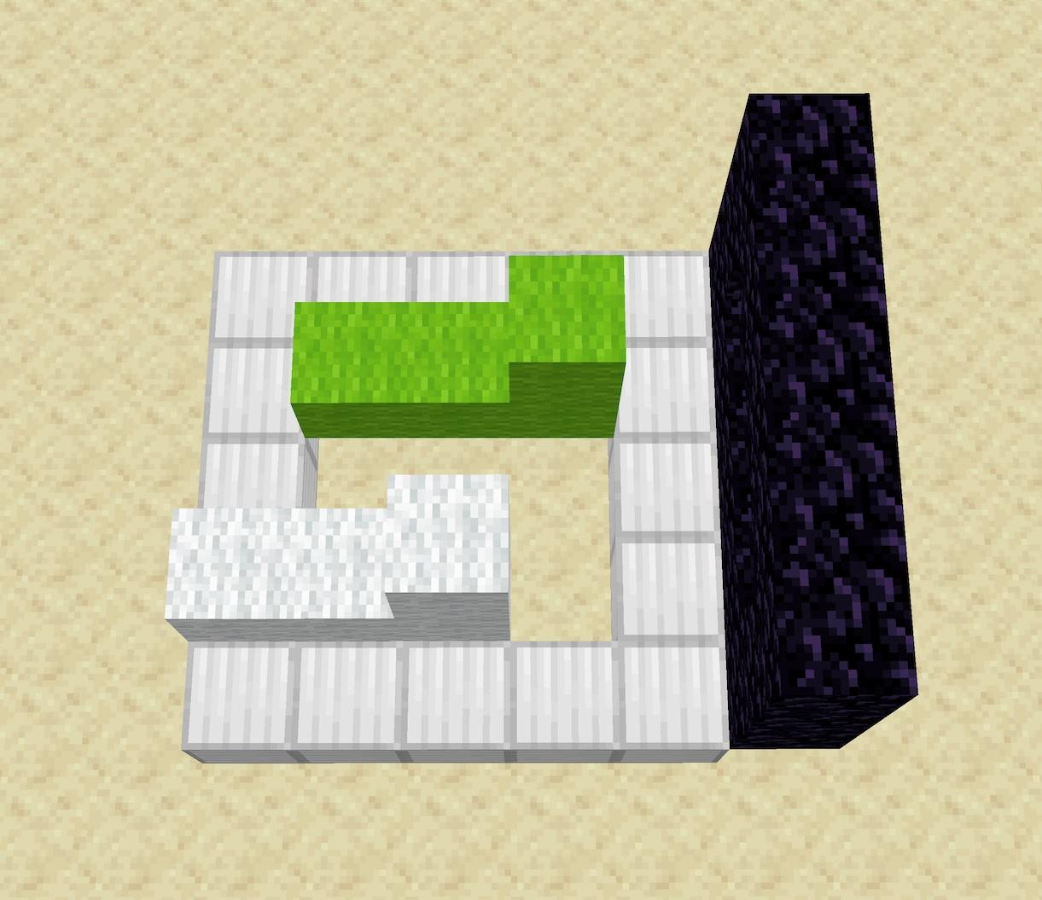
Formalizing Rod Logic
Rules:
0 = blocked
1 = mobile
Can only invert inputs
Cannot invert outputs
1
0
Notes:
Shrink the design space
Can enumerate the available options and choose one

Slide 14
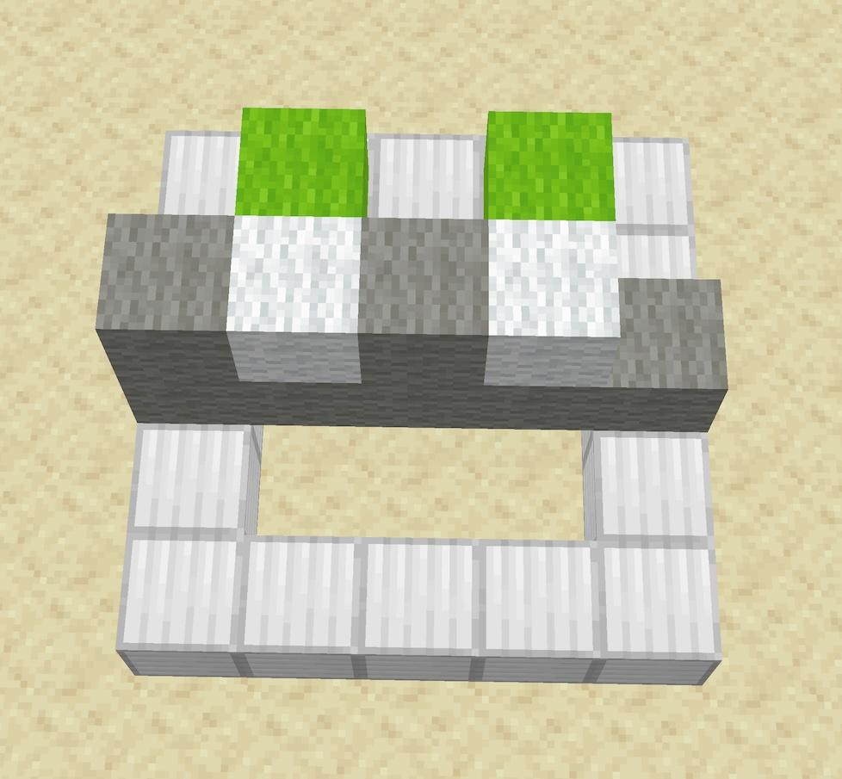
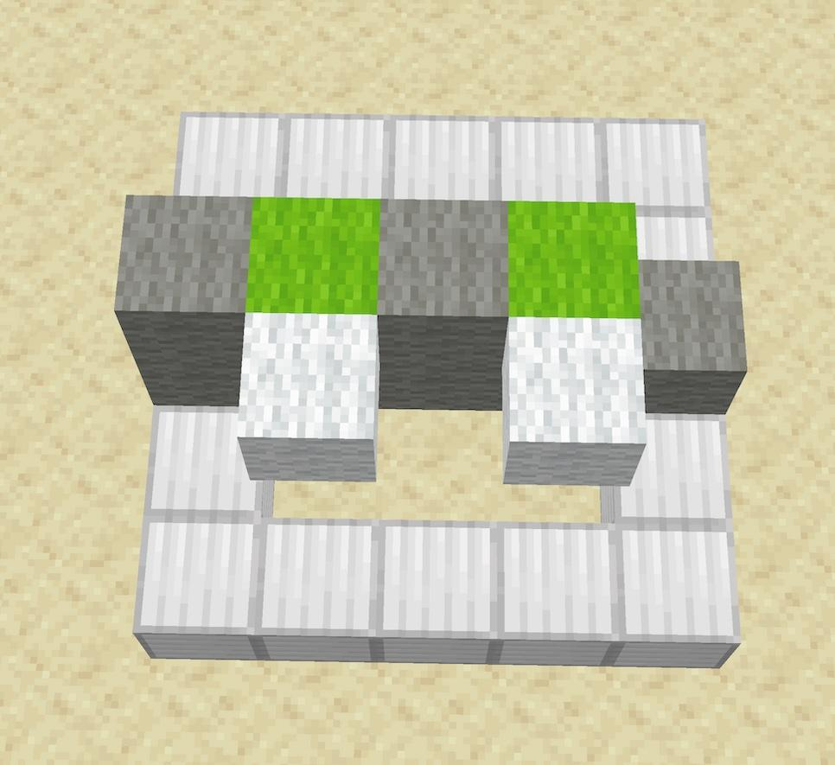
Formalizing Rod Logic
AND gate
NOR gate

Slide 15
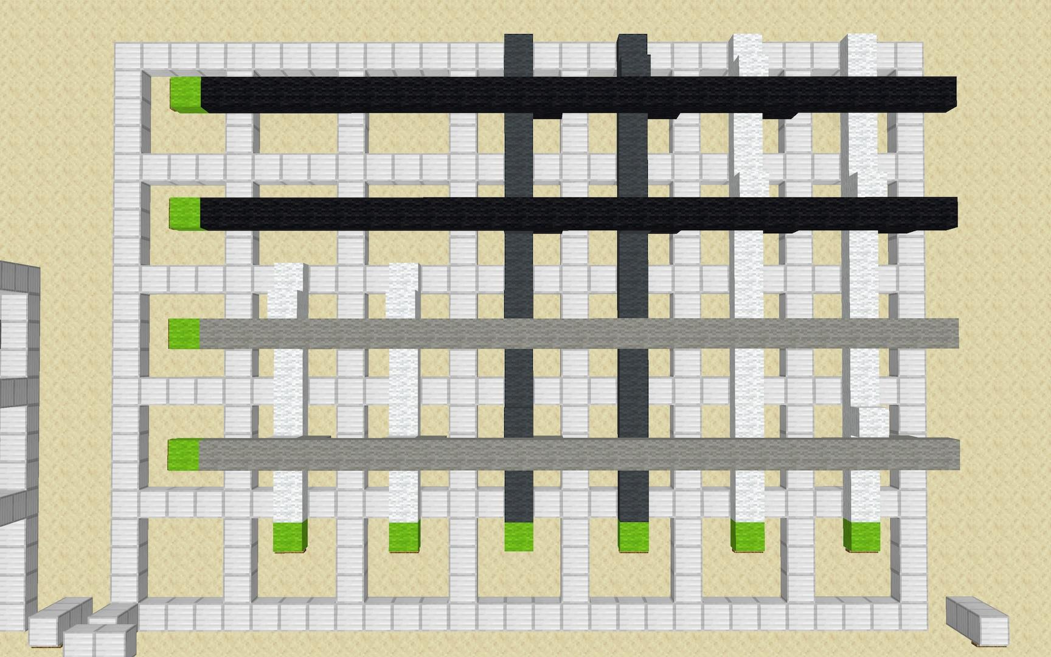
Full Adder
NOR
AND
NOR
AND
A
B
XOR
C_{in}
sum
C_{out}
Notes:
Walk through the sequence of clock phases

Slide 16
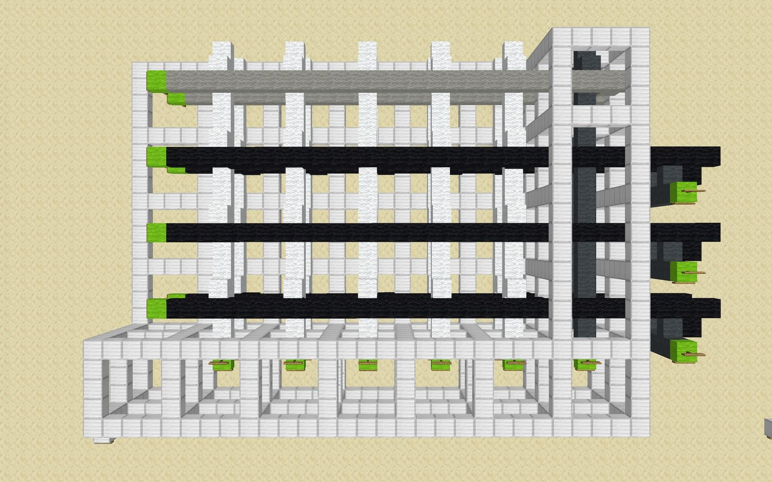
5-to-1 Multiplexer
select[2]
select[1]
select[0]
A
B
C
D
E
out
Notes:
Select signal prevents A/B/C/D/E from actuating

Slide 17
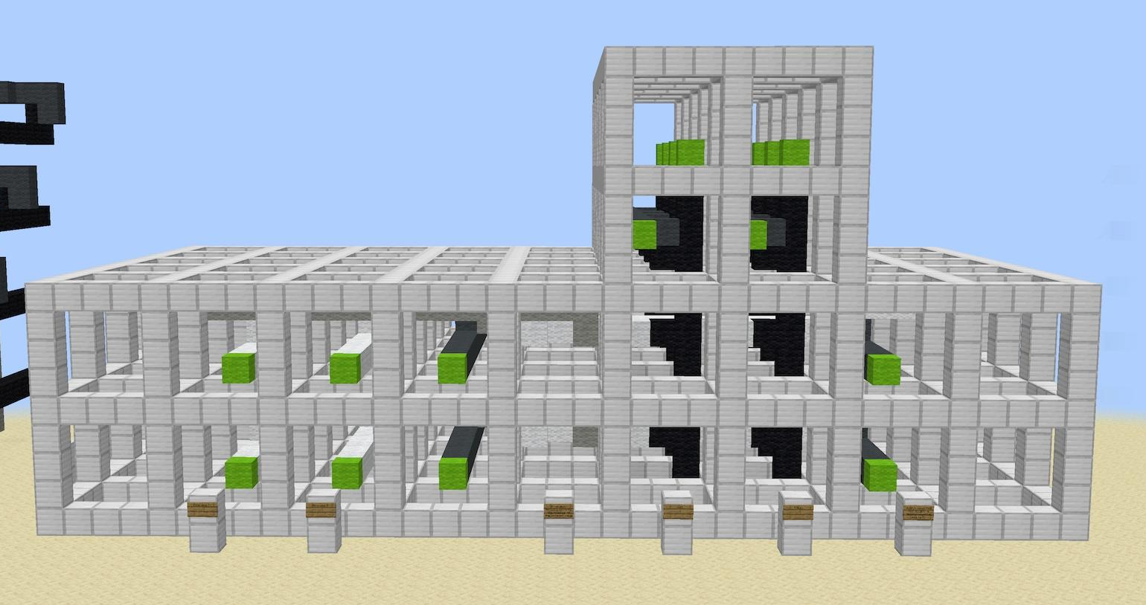
2-Bit Logic Unit
operation select
in[1]
out[1]
in[0]
out[0]

Slide 18
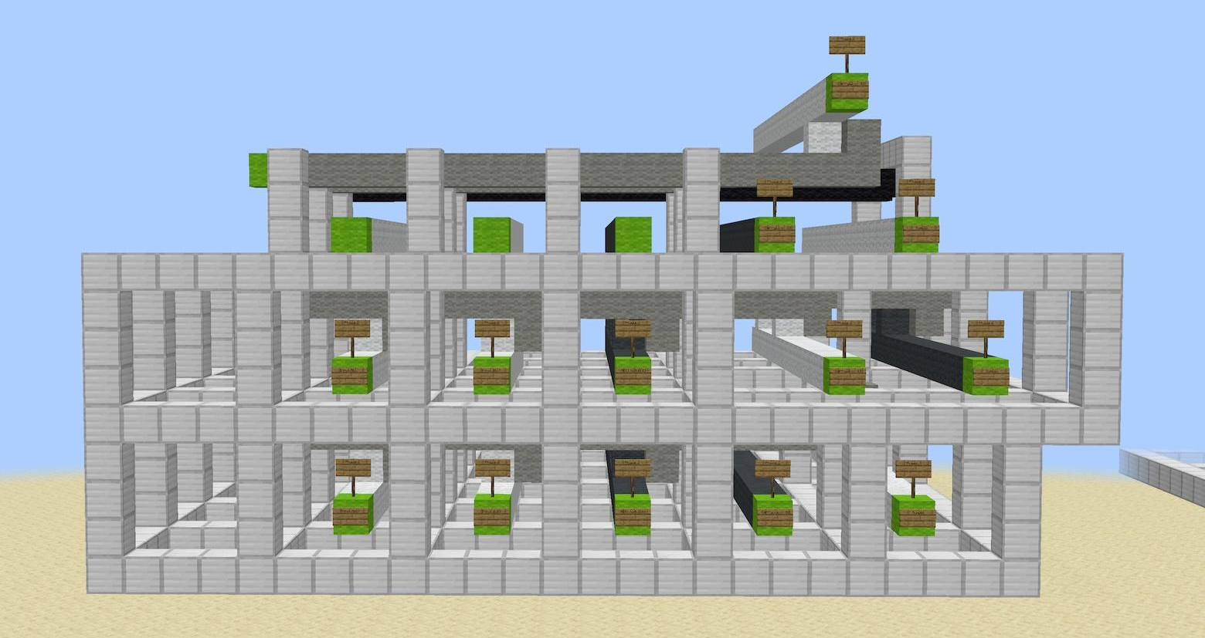
2-Bit Ripple Carry Adder
carry chain
bit 3
bit 2
bit 1
bit 0
inputs
outputs
Notes:
Carry signals are staggered because:
Carry chain employed knobs on top and bottom, to contact the next layer

Slide 19
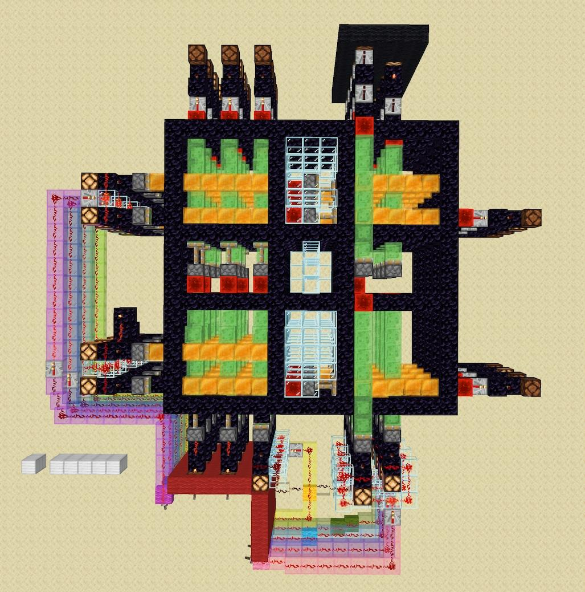
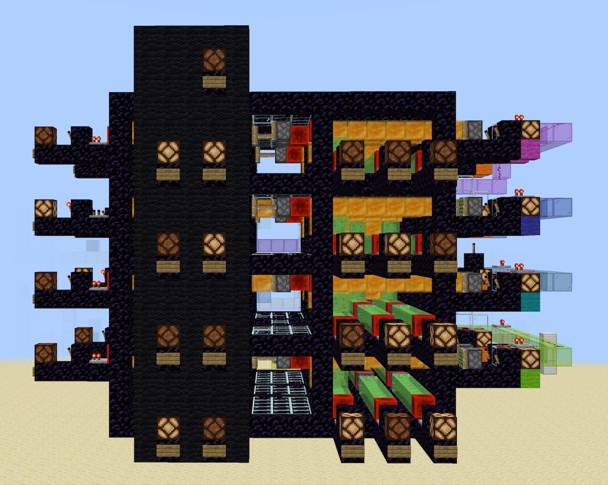
4-Bit Ripple Carry Adder
Aerial view
Output interface
Notes:
Take some time and explain all the data transfers going on here
Explain what each set of redstone lamps indicates

Slide 20
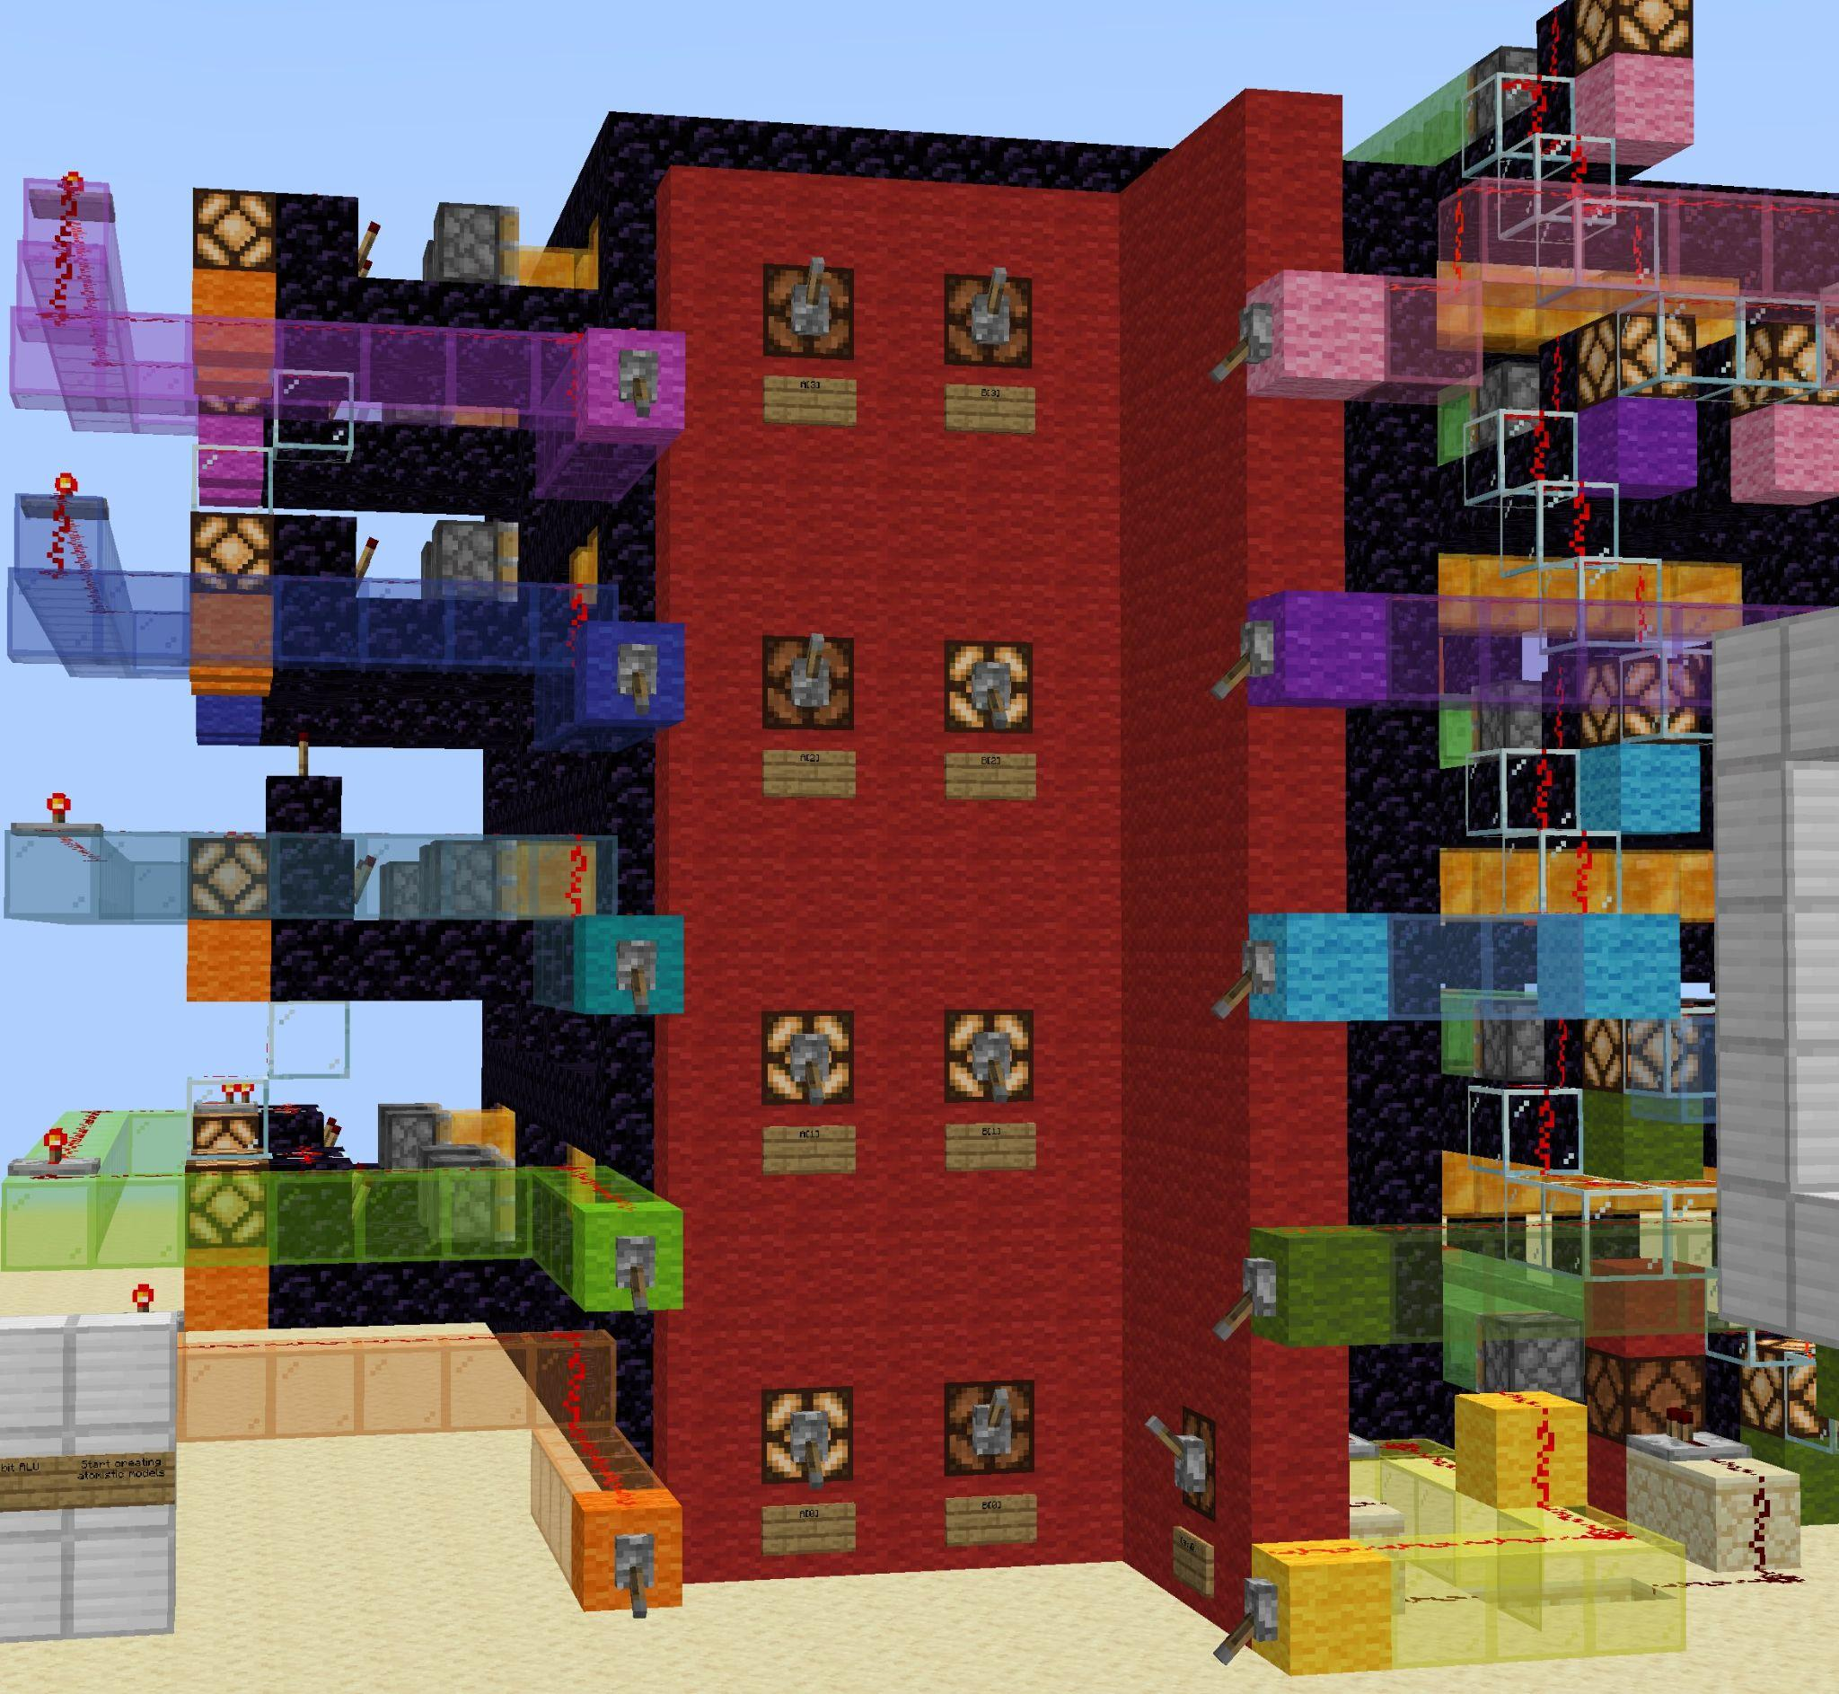
4-Bit Ripple Carry Adder
Achievements:
First reversible 4-bit adder
Forward and reverse clock cycle
Easy to debug
Issues:
10 distinct clock phases
Notes:
Most streamlined debugging experience I have ever done
Put significant effort into the user interface
Ran ~50 different tests in only 30 minutes
Clock phases:
More clock phases means a larger and more complex drive system
Carry lookahead adder needed to reduce the number of phases from 10 to 8

Slide 21
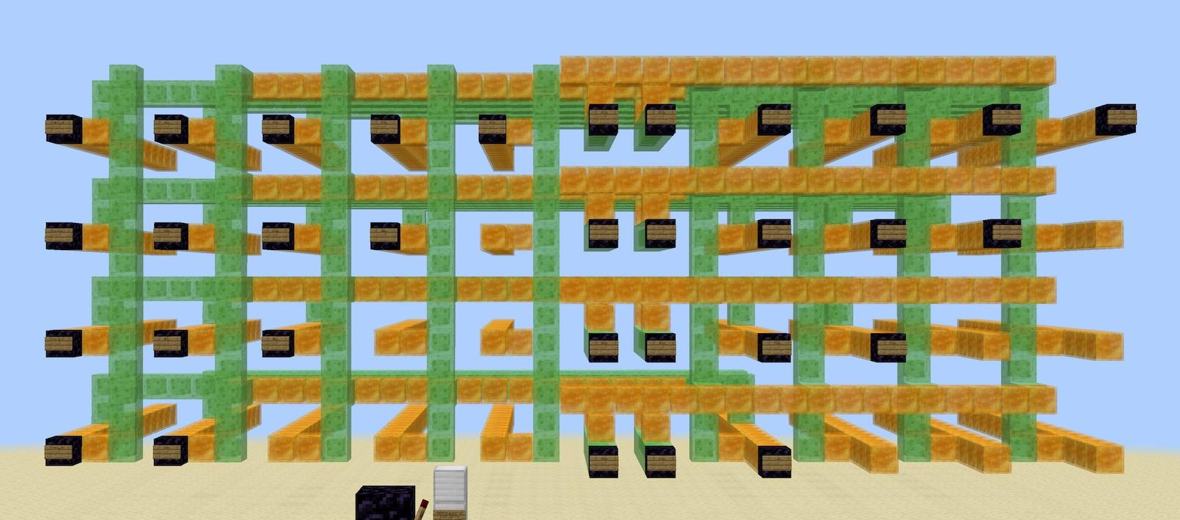
Minecraft Carry Lookahead Adder
6 more design iterations
generate unit
propagate unit
Notes:
Solving remaining conceptual hurdles:
Drafted 4-bit circular shifter to understand how to send data between layers
Note the formation of the concept of “generate unit” and “propagate unit”

Slide 22
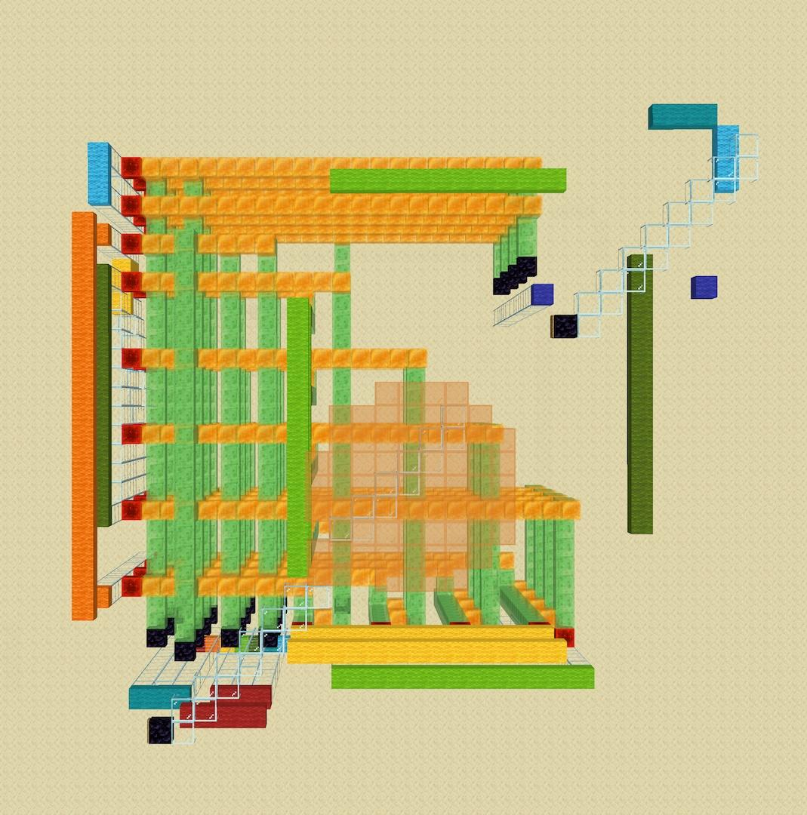
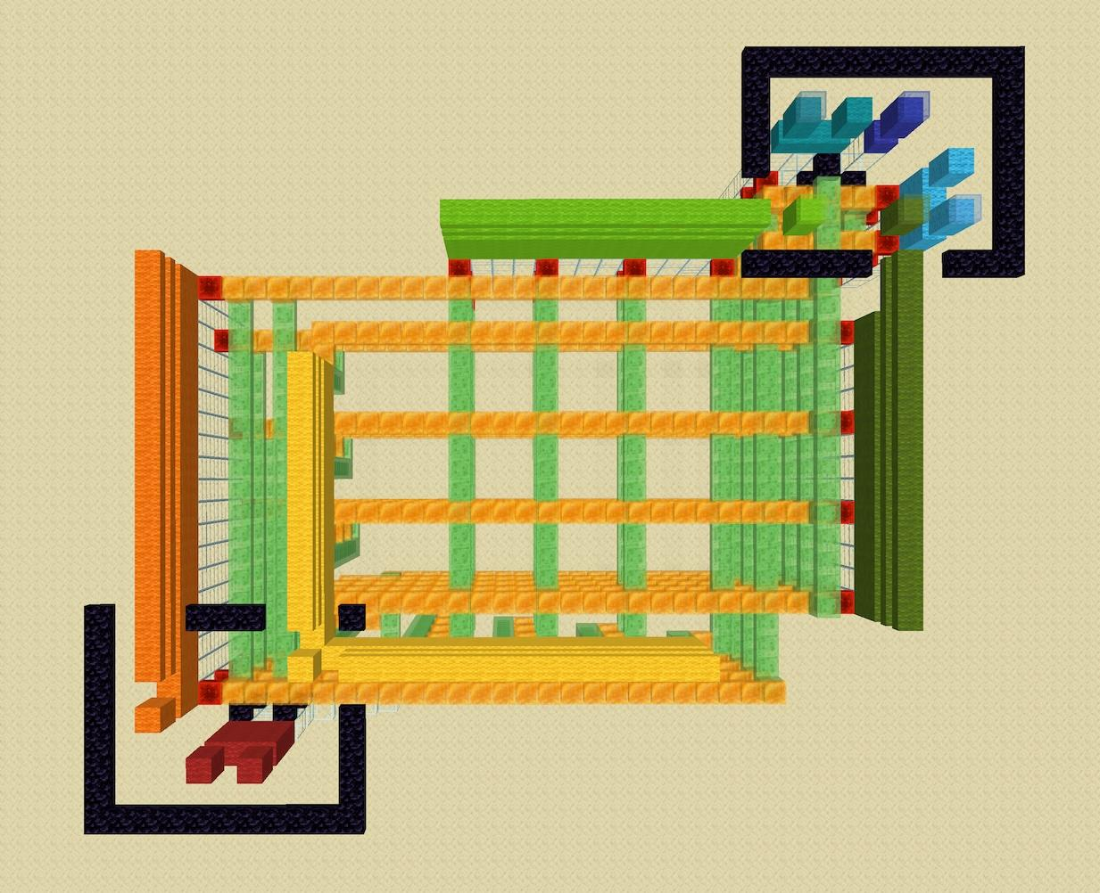
Minecraft Carry Lookahead Adder
clocking sequence
Draft 8
Draft 9
Notes:
Note that the generate and propagate units are now at 90 degree angles
Clocking mechanism is more clear:
Drive walls appear in the same order in time and in space

Slide 23
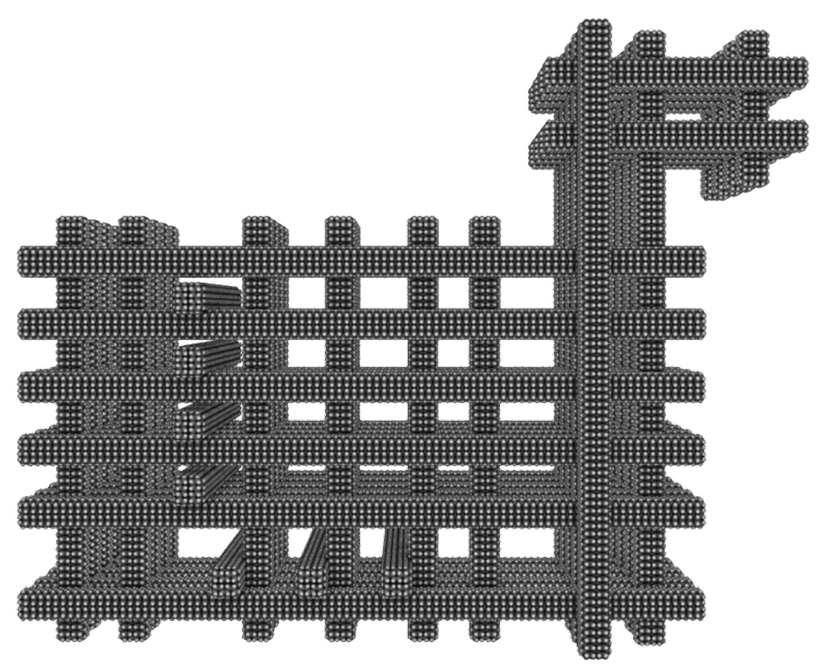
Nanomechanical Carry Lookahead Adder
Draft 13
Notes:
4 more design iterations, this time in atomic detail

Slide 24
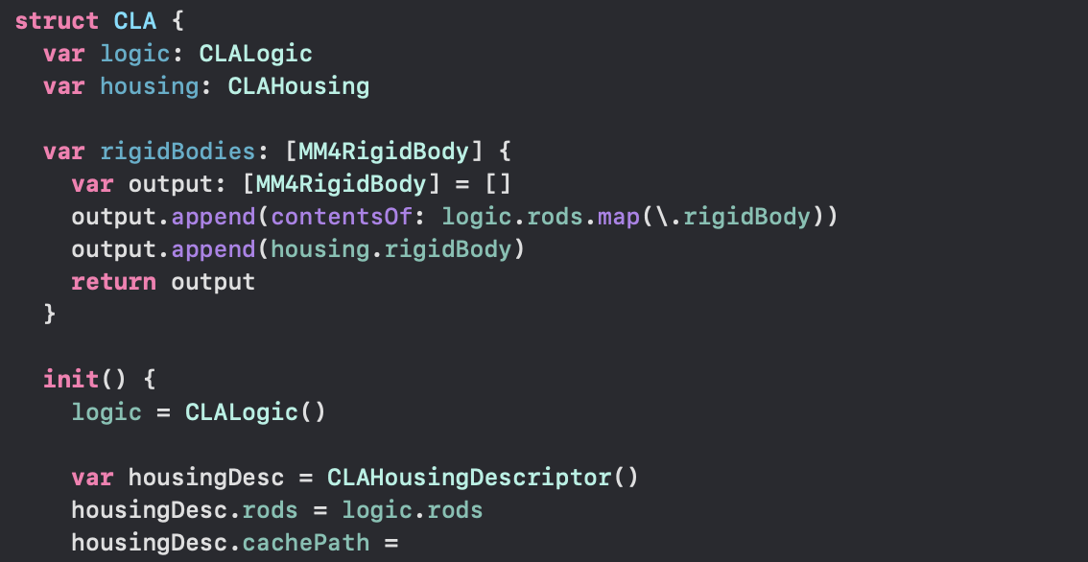
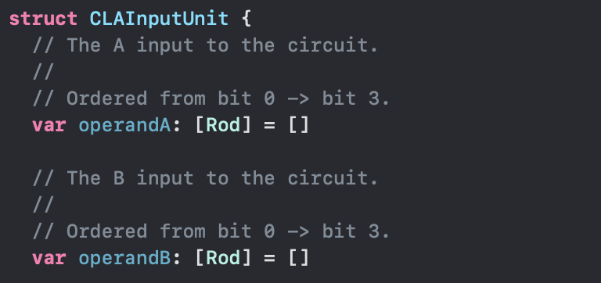
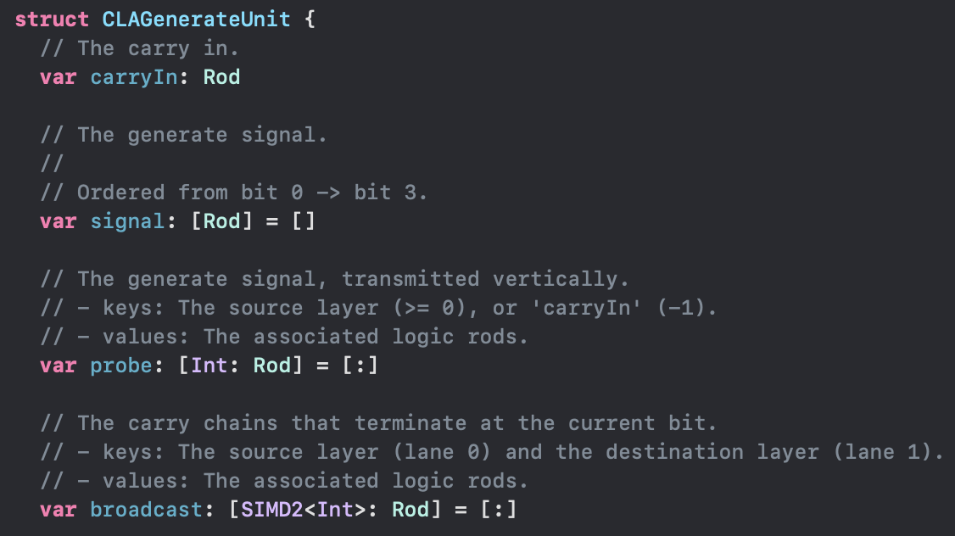
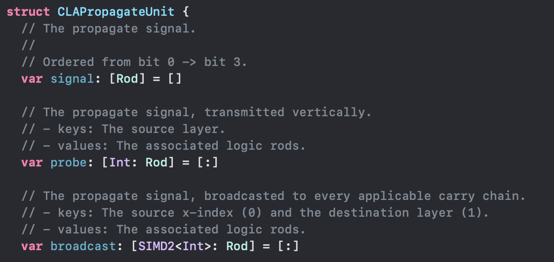
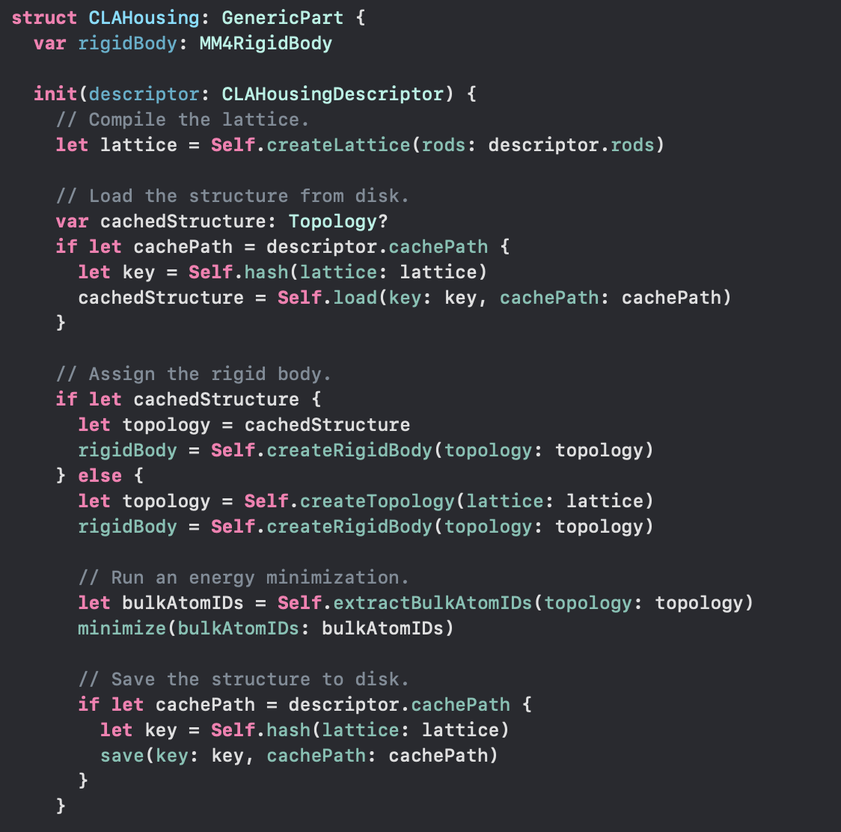
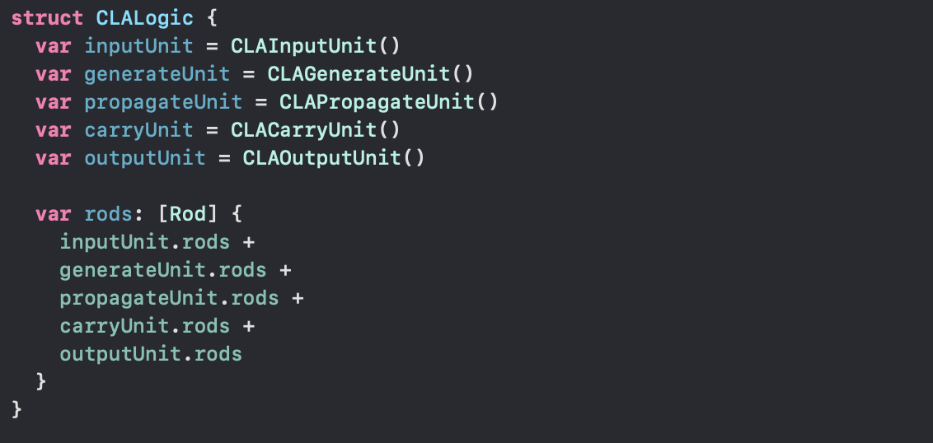
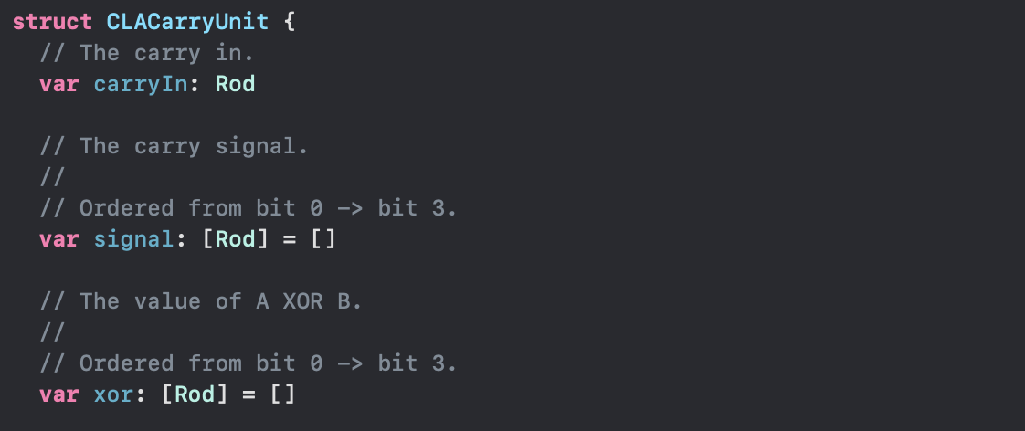
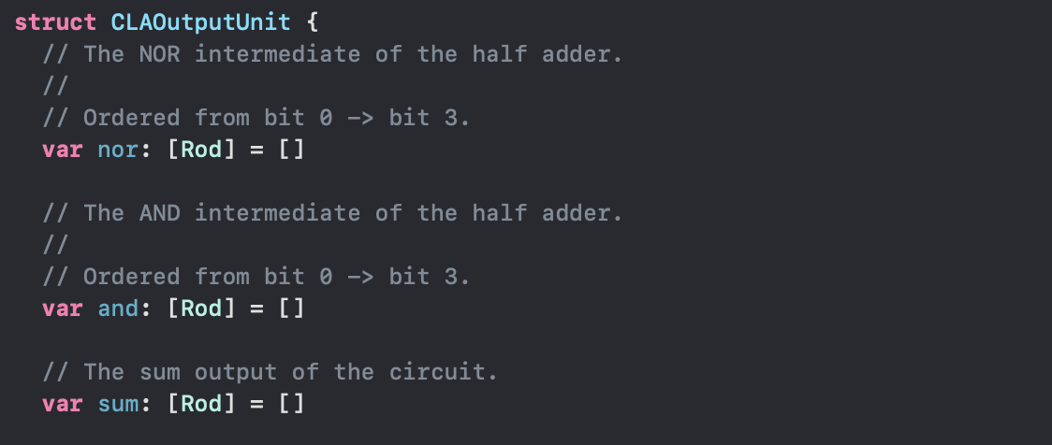
Notes:
Most of the time spent designing rod logic is spent compiler engineering. Only 1% of the time is spent running molecular dynamics simulations.
The format the data is stored in, is not very amenable to representation as a triangularized mesh. It is very different from typical mechanical engineering, which uses point-and-click CAD and finite element methods. Atomically precise systems are pieces of software. Every atom’s location is known exactly and stored exactly. Matter becomes information and be treated like information.
CLAHousing: created a hash out of the lattice. There was a function that took the atom types and atom positions, and made a unique 384-bit hash value.

Slide 25
Logic Layout
Propagate Unit
Output Unit
Generate Unit
Carry Unit
Input Unit
Notes:
[Not discussing the logic units, just using this image as background]
“Why Mechanical Design Cannot Be Like VLSI Design”
Design of electronic circuits has scaled to billions of transistors
Design of mechanical devices has not exceeded thousands of components
With mechanical devices, all the pieces are tightly coupled. No separation of subsystems.
Rod logic breaks this rule
VLSI principles were used to simplify the design
Five functional blocks, each modeled in isolation
Rod logic has much higher fan-out than MLL, one subsystem can connect to multiple other subsystems
If you make the housing stiff enough, each subsystem is separated and decoupled

Slide 26
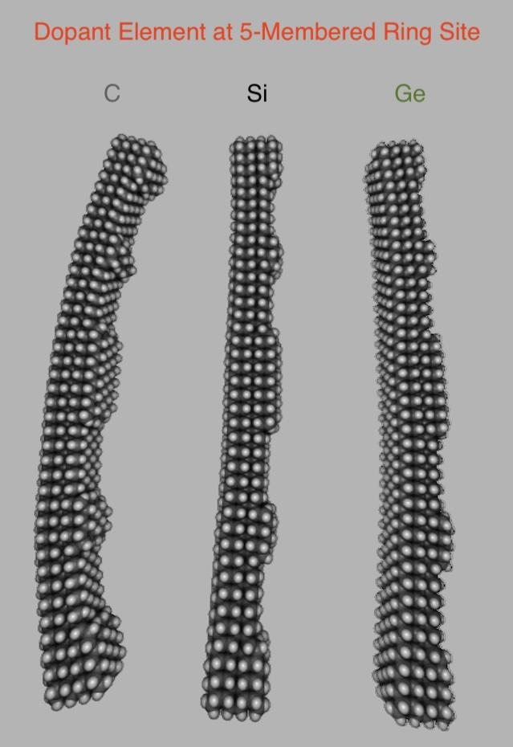
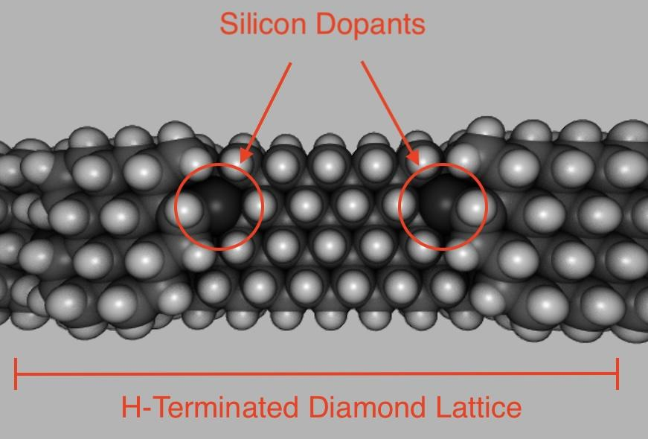
Vertical Logic Rods
Notes:
CLA needs to transfer data between parallel bits. There is no obvious way to do this, with the diagrams in Nanosystems.
Solved 1st problem:
Allow rods to be actuated in all 3 spatial dimensions
Created 2nd problem:
Knobs facing 2 cardinal directions
One of these knobs has 5-membered rings
5-rings shrink the lattice constant
Solved 2nd problem:
Strategically place Si dopants, which expand the lattice constant
The two strains counteract each other
Created 3rd problem:
Lattice now warps along a different axis
Sometimes, you want lattice warping, to create strained shell structures. With linear sliding mechanisms, warping is not a good thing.

Slide 27
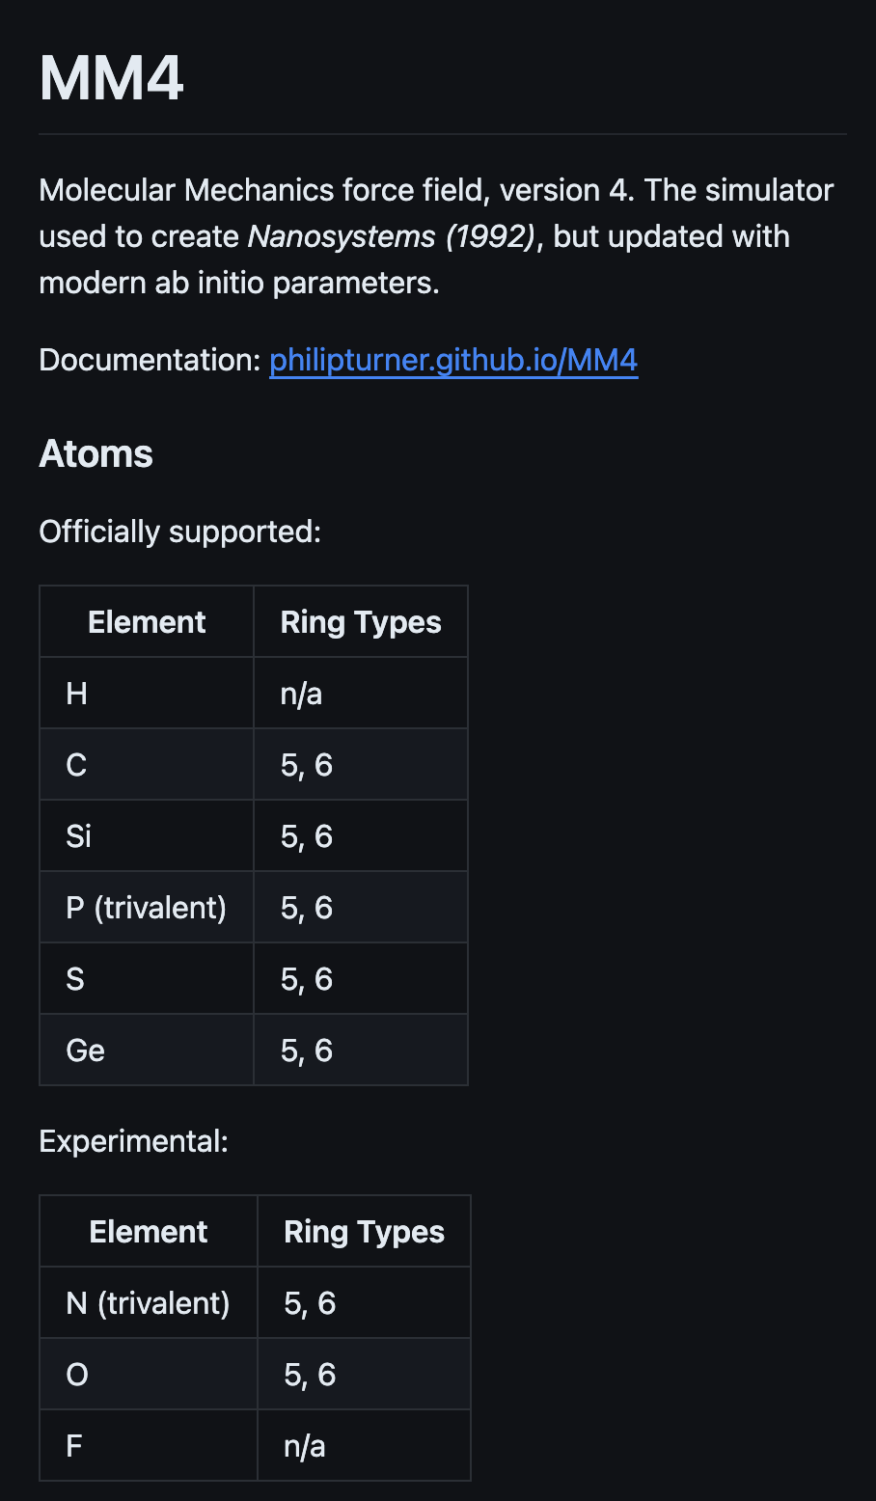
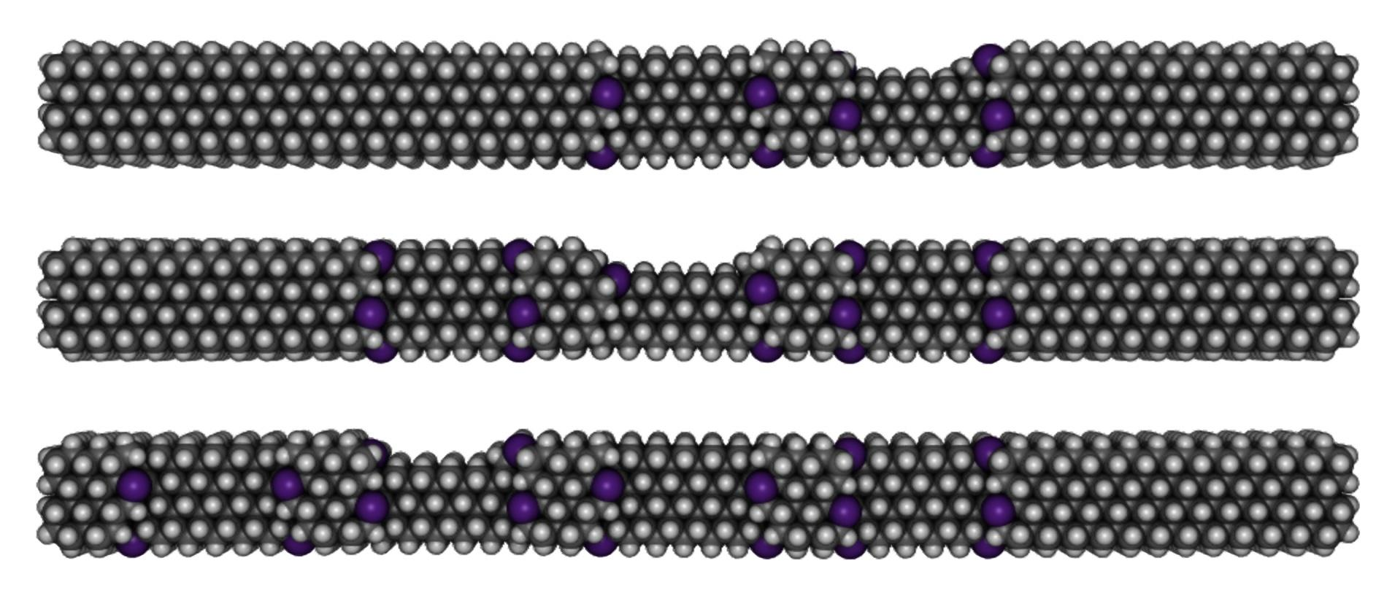
Phosphorus
P dopants
Notes:
The rods shown have gone through the energy minimizer. The warping is very hard to notice.
4-6 phosphorus atoms per knob, compared to 2 with silicon
How does this fix the warping problem?
Phosphorus is one of the few non-carbon elements that is easy to simulate accurately.
Superior to silicon dopants
Localized warping (P is surface, Si is bulk)
Side effects don’t pile up after several knobs
Able to use many more dopant atoms, without them all interacting with each other
Remember that with VLSI, decoupling is the key to scaling.
Each dopant is a subsystem of the knob, which is a subsystem of the pattern.
Subsystems must be isolated to create higher-level abstractions.

Slide 28
Energy Efficiency

Slide 29
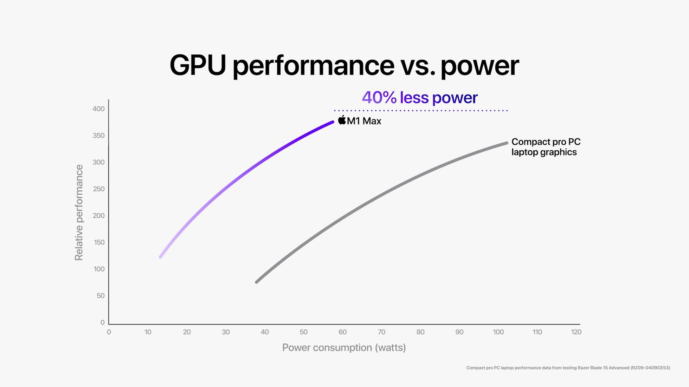

Highly Efficient Electronic Computer
Apple GPU architecture: low clock speeds, small caches
25% of die area

Slide 30
Energy per Switching Operation
≥2707 x 10⁻²¹ J
(50 W) / (1.296 GHz)(57 billion)(≤25%)
≥2164 x 10⁻²¹ J
(12 W) / (389 MHz)(57 billion)(≤25%)
3 x 10⁻²¹ J
Landauer Limit (300 K)

Slide 31
How efficient can consumer electronics get?
TSMC Node | 1 MHz | 389 MHz | 1.296 GHz | 6 GHz
N5 | 2,164 zJ | 2,164 zJ | 2,707 zJ | >10,000 zJ
N3 (35% better) | 1,406 zJ | 1,406 zJ | 1,759 zJ | >10,000 zJ
N2 (35% more) | 914 zJ | 914 zJ | 1,143 zJ | >10,000 zJ
Landauer Limit | 3 zJ | 3 zJ | 3 zJ | 3 zJ

Slide 32
Efficiency of Rod Logic
Dissipation Mode | Scaling | 1 MHz | 1 GHz
Vibrational Excitation | O(v⁴) | 0 zJ | 0.56 zJ
Sliding-Interface Drag | O(v) | 0 zJ | 0.05 zJ
Cam Surface | O(v) | 0 zJ | 0.06 zJ
Thermoelastic Losses | O(1) | 0.41 zJ | 0.41 zJ
 | Energy / Rod | Energy / Switching Event
Forward Cycle | 1.08 zJ | 0.068 zJ
Reverse Cycle | 1.08 zJ | 0.068 zJ
Overall | 2.16 zJ | 0.135 zJ
Landauer Limit | 44.8 zJ | 2.8 zJ
Energy loss, per rod, per cycle (Nanosystems PLA)
Notes:
From my work with simulations, these estimates do seem reasonable. Quantities on the order of a few zeptojoules per rod.
Found a typo in Nanosystems. With the correction to 0.13 zJ, these estimates are a lot more believable.
It takes a lot of trial and error to make an efficient system. These numbers would be plausible after several rounds of optimization.
Note that:
Nanosystems logic array: 32 switches per rod
4-bit CLA: 4–8 switches per rod → energy / switch is higher

Slide 33
Efficiency of Rod Logic
 | 1 MHz | 1 GHz | 6 GHz
TSMC N5 | 2,164 zJ | 2,707 zJ | >10,000 zJ
TSMC N2 (optimistic) | 914 zJ | 1,143 zJ | >10,000 zJ
Landauer Limit | 2.8 zJ | 2.8 zJ | 2.8 zJ
Rod Logic | 0.051 zJ | 0.135 zJ | cannot operate
Molecular Link Logic | TBD | TBD | cannot operate
Rod logic is theoretically ~15,000x more efficient than CMOS.
Rod logic is theoretically ~40x more efficient than Landauer limit.
Notes:
Hyper-efficiency only applies to combinational logic.
Rod logic registers are still bound by 2.8 zJ.
Rod logic and MLL are bottlenecked by registers.

Slide 34
Proposed Operating Speeds
1 MHz
1 GHz
Factories and robots
Massively parallel AI training
Energy dominated by O(1)
Competitive with electronics
Personal computers (CPUs, GPUs)
Energy dominated by O(v)
K = ½ m v²
How is kinetic energy recovered?
Notes:
Explain each operation mode
Wrap up by stating: both operation modes theorized <2.8 zJ per switching operation
How is kinetic energy recovered?
Good question
Hoped to answer it with a simulation
Prove that it’s not something like 100 zJ per switching event
Was working on a method for testing energy efficiency.
Create an isolated system that obeys the second law of thermodynamics.
Power source must be part of the system
Flywheel is a very dense form of mechanical energy
Went through one design iteration, simulation failed horribly.
Working on second iteration, with a planetary gear system.
Deleted section about flywheel
Presentation was already very long
Too busy with finals to finish the flywheel
Presentation is about linear sliding mechanisms. Not rotary links and rotary gears.

Slide 35



Nanomechanical Carry Lookahead Adder
685,431 atoms
26 nm x 13 nm x 21 nm
21
26
13
Notes:
Therefore, I am ending the presentation with slide. The smallest 4-bit adder permitted by the laws of physics.
This was the result of months of compiler engineering. A self-contained set of source files, that can generate the static structure for a 4-bit adder. I have not yet simulated whether this works correctly or works efficiently. I reached the point where there is array of atoms to enter into the simulator. Now, I can begin trial and error, fixing bugs and optimizing energy consumption.
The first time in 30 years, that a major university has sponsored molecular nanotechnology. It was an honor to work on this project.

